Slide 1
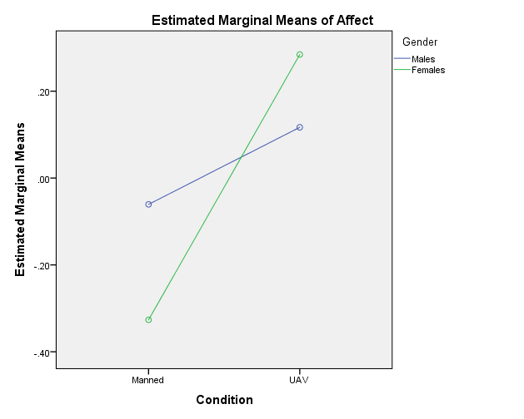
Perceptions on the use of Manned and Unmanned Combat Aircraft Vehicles: An Affective Perspective
College of Aeronautics
Zak Inmon and Scott R. Winter
Background
The use of Unmanned Combat Aircraft Vehicles (UCAV) have increased since the early 2000’s.
UCAV’s enable the operator of the aircraft to manipulate the controls hundreds/thousands of miles away from the battlefield and therefore safe from enemy harm.
This, along with the transition of their use from reconnaissance to combat aircraft has brought about cultural and ethical concerns.
The purpose of this study was to understand and study the affects of the public and their emotional responses when asked how they feel about unmanned combat aircraft vehicles (UCAV) used as weapons in instances of war vs. manned combat aircraft used as weapons in instances of war.
Factors such as the condition, culture and gender were evaluated.
Average Affect Scores
Future Research
Further research and study should be completed to determine how culture and gender effect a participant’s affect/emotion and how those factors effect UCAV perceptions and implementations.
Future research and study should strive to collect data from other countries, and also attempt to examine how these factors along with other components, influence UCAV perceptions and implementation.
Further research and study should be performed to confirm the accuracy of this study’s results.
Results
Discussion
This study has several practical implications shown by the affect scores, and could be of value to defense departments along with war ethics professionals.
Since UCAV was preferred by participants, it is possible that their usage could lower the criterion in which a state enters a war. (Jus ad Bellum)
It is possible that consumer perceptions would agree with the utilitarian approach to UCAV usage and therefore not view them as unfair or asymmetric.
It is interesting to note the different characteristics between American individualistic culture and Indian collectivistic culture that could have contributed to the overall differences in affect scores among participants from the different countries.
This study confirms that lower risk levels are associated with females over their male counterparts.
A 2 x 2 x 2 Factorial ANOVA was conducted. There was a significant main effect of condition F(1, 376) = 13.34, p < 0.001, partial eta squared .034, and a significant main effect of country F(1, 376) = 102.26, p < 0.001, partial eta squared .214. There was also a significant interaction between Condition*Gender F(1, 376) = 4.03, p < 0.5, partial eta squared .011.
The findings of this study, as represented by the significant main effect of country is shown by the overall difference of affect scores between Americans and Indians.
The findings of this study, as represented by the significant main effect of condition is shown by an overall increase in emotion in favor of UCAV.
The findings of this study, as represented by the significant interaction between gender and condition is shown by the females higher score for UCAV and lower score for manned aircraft.
Method
It was predicted that:
H₁: There will/will not be a conditional difference in response from participants regarding an unmanned vs. manned operator of an aircraft vehicles used to carry out a mission in war acts.
H₂: There will/will not be a cultural difference in response between American and Indian participants regarding unmanned vs. manned aircraft vehicles used to carry out a mission in acts of war.
H₃: There will/will not be a gender difference in response between male and female participants regarding unmanned vs. manned aircraft vehicles used to carry out a mission in acts of war
H₄: There will be some interaction between variables regarding an unmanned vs. manned aircraft vehicles but this hypothesis will be non-directional.
IRB Approval
Survey of 384 participants (154 Females) from India and the United States using Amazon’s ® Mechanical Turk ®
Rated their affect (Emotion) when presented a scenario of an unmanned or manned combat aircraft vehicle being used to carry out missions for their country.
Finally, they were asked a variety of demographics questions.
5-point Likert type scale from -2 (Strongly Disagree) to +2 (Strongly Agree) with a neutral option of zero.
Gender & Condition
Selected References
Johansson, L. (2011). Is it morally right to use unmanned aerial vehicles (UAVs) in war? Philosophy & Technology, 24(3), 279-291. doi:http://dx.doi.org/10.1007/s13347-011-0033-8
Strawser, B. (2010). Moral Predators: The Duty to Employ Uninhabited Aerial Vehicles. Journal of Military Ethics, 9(4), 2943-2964. Retrieved September 14, 2015, from http://www.tandfonline.com.portal.lib.fit.edu/doi/full/10.1080/15027570.2010.536403
Winter, S., Rice, S., Mehta, R., Cremer, I., Reid, K., Rosser, T., & Moore, J. (2014). Indian and American consumer perceptions of cockpit configuration policy. Journal of Air Transport Management, 226-231.

