Slide 1


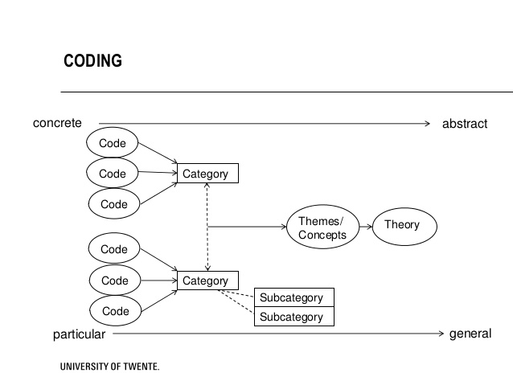

Critical Success Factors for Student Transition: A Case Study of Chinese Collegiate Aviation Students at a Midwestern University
Yu Wang, Julius Keller, &
Ching Hei Lo
Advisor: Dr. Richard Fanjoy
Abstract
Results
High Level of English Skills
Whether the participants thought their skills were good or not, they understood the importance of practicing English prior to arriving in America and progressing after their arrival. A high level of English skills assists them with classroom understanding, homework, writing papers, and giving presentations. Some participants expressed, the minimum English testing requirements such as the TOEFL may not be sufficient preparation depending on the background of the student.
Support from Faculty Members
Interactions between faculty members and students may be different in America when compared to China. A plausible explanation may be power distance. Positive one-on-one interactions with professors was a common theme among participants. They felt encouraged by the support from their professors. A positive interaction can shape student perceptions and behavior. Chinese students should be informed about the cultural differences and encouraged to approach faculty.
Opportunities to Engage in Aviation Related Projects (Academic and Industry)
Most participants had an opportunity to engage in projects connected to the industry. This is a primary reason for choosing the aviation program studied in the first place. Respondents often felt America was best place to learn aviation not only because of history but also the connection to the industry. Projects assist students in career pathways, education, and training. Most respondents felt projects were a positive and critical part of their experience.
Due to a world-class education system, an increasing number of international students are choosing to study abroad in the United States. According to the Institute of International Education (2015), Chinese students account for the largest foreign demographic with over 274,000 enrollments. A smooth transition to a new study environment plays an important role in determining academic success of international students (Hellsten, 2013). Issues such as language barriers, cultural differences, different modes of thinking and learning, may create challenges for international students (Hellsten, 2013). Aviation is a highly global industry and there are an increasing number of Chinese students coming to the U.S. to study aviation. This study sought to identify critical success factors (CSFs) to gain a clearer understanding of Chinese collegiate aviation student perceptions regarding a successful transition to a U.S. study environment. Participants were eight undergraduate and graduate students from a Midwestern university. Semi-structured interviews were utilized and audio recorded for data collection. Researchers analyzed data by means of coding and categorizing interview transcripts. Along with the results, recommendations for Chinese student transition are presented.
The researchers of this study identified three critical success factors for Chinese collegiate aviation student transition based on the findings of interviews. They are high level of English skills, support from faculty members, and opportunities to engage in aviation related projects.
Researchers used a survey consisting of 23 questions. Twenty Likert scaled questions and 3 open ended. The questions explore power distance, collectivism-individualism, uncertainty avoidance and masculinity-femininity. Three open ended questions are linked to the cultural dimensions. Questions were evolved from previous research to fit the scope of study.
Methods
After obtaining IRB approval, participants were contacted via email. Through purposeful sampling, four undergraduates (2 female & 2 male) and four graduates (2 female & 2 male) were selected for the study. Over the course of 2 weeks, semi-structured interviews were completed. Each interview lasted for approximately 30 minutes
Once the transcribing was completed, researchers sent the audio recordings and transcripts to participants for member checking. Researchers then independently analyzed the data to determine the top three CSFs. Themes were generated through categorizing and coding. After one round, researchers came to a consensus and expanded upon the selected themes for reporting.
Procedures
Introduction
Create interview questions
Validate interview questions
Recruit interview participants
Conduct and audio-record Interviews
Transcribe interview recordings
Conduct member checking for transcripts
Analyze data by coding and categorizing
Come to a consensus based on themes
Create a list of critical success factors
According to Allen-Ebrahimian (2015), since the 2004-2005 academic year, the number of Chinese international students seeking higher education in the U.S. has increased by nearly 5 fold. In the 2014-2015 academic year, there were 304,040 Chinese students studying state-side. This was a 10.8 percent increase over the 2013-2014 school year. Currently, of the 974,000 international students in the U.S., one in three is Chinese. This increase is said to be due to the rising middle class population in China, coupled with the U.S.'s prominent reputation for college-level education (Allen-Ebrahimian, 2015). Very few research studies have been conducted to identify key factors for Chinese aviation student transition.
This research study was aimed to identify key factors for a successful transition to study aviation in the U.S. for Chinese collegiate aviation students. Results reported in this poster are the first part of a broader study. During the second part of the study, the participants will rank the factors. Then researchers will use the Analytic Hierarchy Process (AHP) to statistically analyze the rankings. Additionally, theories will be generated and tested in follow studies. Future results will be reported in subsequent papers.
Discussion
Regarding the first critical success factor, a recommendation for department leadership is to create a structured program which connects Chinese students to American students. The purpose would be to foster interactions that may improve English skills and to improve the understanding of American culture.
For the second critical success factor, there may be a link between positive interactions with professors and self-efficacy. Professors often hold the key to additional projects which introduce students to industry engagement. These projects may improve student education and career opportunities.
Concerning the third critical success factor, the opportunity to choose their projects may be also important for students to have a smooth transition. Program managers can continue to increase research and project opportunities. This can be a great area for recruitment and retention opportunities.
Research Question: What are critical success factors for a successful transition to a U.S. study environment for Chinese collegiate aviation respondents?

