Slide 1
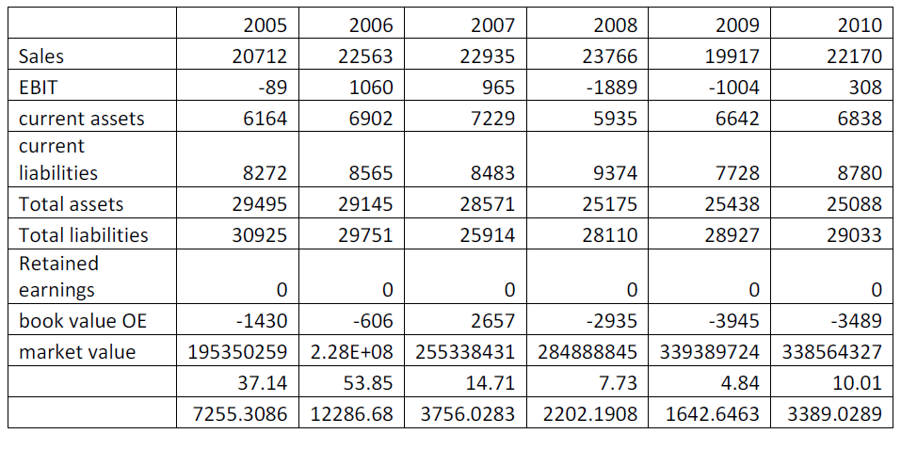
Examination of Bankruptcy Prediction Models
An empirical analysis of American Airlines
Student: Yousef Almomani Faculty Advisor: Dr. Chun-Pin Hsu
Abstract
Introduction
The 1968 Model
The Data
In the past few decades, several US based airlines filed for bankruptcy protection under Chapter 11 of the United States Bankruptcy Law. Since airlines are both labor and capital intensive industry and strongly engaged with the financial markets and economics indices, when a major airline files for bankruptcy protection, the impacts will not only limit to the airline itself but the whole economy. Therefore, how to accurately predicate an airline’s possibility to file for bankruptcy protection is an important subject in Aviation Finance. In this study, we examined the power of several bankruptcy prediction models in estimating bankruptcy possibilities of American Airlines. Specifically, we adopt the three Z-score models developed by Altman in 1968, 1983, and 1993 respectively. Our empirical results indicate the although the three models are quite powerful in estimating bankruptcy possibilities in other industries, they may not fit in the American Airlines case.
Although the 1968 model seemed to be efficiency, one of the components in the model required “stock price” of the evaluating company. This may not be appropriate for private holding companies as those companies are not public traded and do not have information for their stock prices. To copy with the problem, in 1983, Altman revised the 1968 model and used book value to replace market value in the 1983 model.
In 1993, Since Altman felt that the fifth ratio in his models couldn’t present a difference between failed and non-failed firms, he revised his models again and introduced a newer model.
Since airlines are both labor and capital intensive companies and the business models are quite different from manufactural companies. The aviation industry merits our study to examine if the Altman models could still apply to the airlines.
Our empirical study included the three Altman models and utilized American Airlines’ case as the company filed for Chapter 11 bankruptcy protection on 29 November 2011 example.
Model I: Z Score (Altman 1968)
X1: Working Capital/Total Assets
X2: Retained Earnings/Total Assets
X3: EBIT/Total Assets
X4: Market Value Equity/Book Value of Total Debt
X5: Sales/Total Assets
Z = 1.2X1+ 1.4X2 + 3.3X3+0.6X4 + 0.999X5
Z<1.81 Bankruptcy within a year
Z>2.67 Non Bankruptcy
2.67>Z>1.81 Gray area
The 1983 Model
Empirical Results and Discussion
Model II: Z Score (Altman 1983)
X1: Working Capital/Total Assets
X2: Retained Earnings/Total Assets
X3: EBIT/Total Assets
X4: Book Value Equity/Total liabilities
X5: Sales/Total Assets
Z’= 0.717X1+0.847X2+3.107X3 + 0.420X4+ 0.998X5
Z<1.23 Bankruptcy within a year
Z>2.90 Non Bankruptcy
2.90>Z>1.23 Gray area
The empirical results of the three Z scores are reported in the following table. According to the results, American Airlines were in the bankruptcy zone since 2005 and continue stayed in the bankruptcy zone during the whole date period.
In reality, American Airlines didn’t go bankrupt until November 29, 2011. Therefore, the Z score models may not fit in the American Airlines’ case.
Introduction
The 1993 Model
Whether a company will go bankrupt is an important issue in the field of finance. When a big firm goes bankrupt, it will cause serious impacts on both stock holders and stakeholders. Theoretically, if investors and stakeholders could predict a firm’s possibility of going bankrupt, the impact may be reduced.
Altman pioneered the study of bankruptcy prediction and introduced his first Z-score model. This model was based on a study of 66 firms and claimed that the model had 95% success rate in bankruptcy prediction.
Model III: Z Score (Altman 1993)
X1: Working Capital/Total Assets
X2: Retained Earnings/Total Assets
X3: EBIT/Total Assets
X4: Book Value Equity/Total liabilities
Z’’ = 6.56X1 + 3.26X2 + 6.72X3 + 1.05X4
Z<1.10 Bankruptcy within a year
Z>2.60 Non Bankruptcy
2.60>Z>1.10 Gray area
Future Work
In the future, we plan to extend this examination to other airlines to determine the prediction capabilities of the Altman Z-Score and its revised models in the aviation industry.
References
Altman E.I. (1968). “Financial Ratios. Discriminant Analysis and the Prediction of Corporate Bankruptcy”. in The Journal of Finance. pp. 589-609.
Altman E.I. (1983). Corporate Financial Distress. Wiley Interscience. New York.
Altman E.I. (1993). Corporate Financial Distress and Bankruptcy: A complete Guide to predicting and avoiding distress and profiting from bankruptcy. Wiley. New York.

