Slide 1
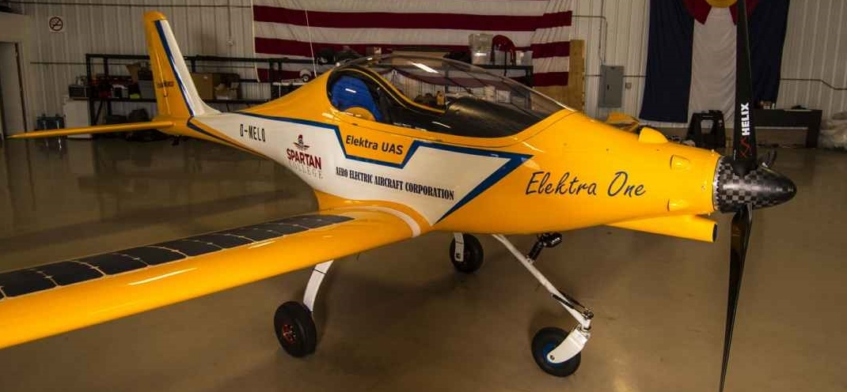
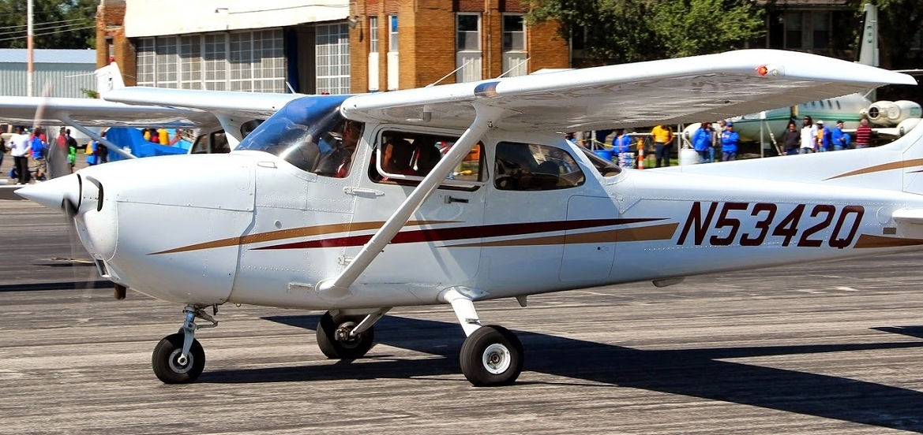
Viability of Electrically Powered Aircraft
Matthew S. Heberlie and Mentor: Steven C. Goetz
Southern Illinois University Carbondale—Department of Aviation Management and Flight
Objectives
Abstract
Results
Aero Electric Aircraft Corporation’s Sun Flyer, arguably the most modern fully-electric aircraft to date, was used in this study to test the viability of electrically powered aircraft at Southern Illinois University Carbondale (SIUC).
This study investigated whether the Sun Flyer could replace the Cessna 172R Skyhawk at SIUC.
This study compared the performance and expenses of each aircraft.
The costs of operating aircraft in a training environment have substantially increased, thus deterring future aviation students from pursuing careers as pilots. As the cost of flight training continues to increase, the student loan debt of pilots is also increasing. In an act to counter this, research has been conducted to examine alternative forms of energy to power aircraft. Instead of retrofitting internal combustion engines, the most feasible option that appears to resolve this issue is through the implementation of electrically powered aircraft. This type of aircraft could reduce costs of operation substantially across training fleets throughout the United States, particularly at Southern Illinois University Carbondale (SIUC). The Cessna 172R Skyhawk, being the main aircraft utilized for flight training at SIUC, will be used to provide internal combustion data as a control. This data will then be compared with the data collected from electrically powered aircraft. To date, SIUC has not conducted any research on the integration, advantages, or drawbacks of electrically powered aircraft. The objective of this comparison is to explore the viability of incorporating electrically powered aircraft at SIUC. Simultaneously, this study could act as a catalyst for future research in electrically powered aircraft integration across flight training environments.
Sun Flyer:
Almost half the cost of the Cessna 172R Skyhawk.
Substantially cheaper to operate.
Cessna 172R Skyhawk:
Longer endurance.
Farther range capabilities.
Faster speeds.
Can hold more passengers.
Wide useful load range.
Discussion
Methods
Both the Sun Flyer and the Cessna Skyhawk have their advantages and disadvantages.
The Sun Flyer is substantially cheaper to operate, but lacks the performance capabilities of the Cessna Skyhawk.
The Cessna Skyhawk has the performance desired in flight training environments, but at a much higher annual cost than the Sun Flyer.
Data for the Cessna Skyhawk was recorded from a database at Southern Illinois University Carbondale (SIUC) that categorized average operational cost statistics of aircraft owned by SIUC. The data consisted of the acquisition of the aircraft, fuel, and maintenance costs per year. Because cost comparisons between aircraft would be difficult to test without having hours of operation, the average total hours flown in one year by the Cessna Skyhawk were used by both aircraft to allow accurate yearly comparisons.
Other information useful for comparison was taken from the Pilot Operating Handbook for the Cessna Skyhawk. This data included endurance of the aircraft, range, number of seats, and the useful load. Useful load is defined as the load able to be carried by an aircraft in addition to its weight.
That data was then compared with statistics proposed by Aero Electric Aircraft Corporation (AEAC) for their Sun Flyer. Statistics used for this aircraft were received from an interview that was conducted with George Bye, the CEO of AEAC.
Comparison of Aircraft Costs and Performance
 | Cessna 172R Skyhawk | AEAC Sun Flyer (Preliminary)
Acquisition ( principle cost per year for seven years) | $52,142 | $28,572
Fuel (Gallons/Kilowatt Hours per year) | $24,750 at $5.42/Gal | $309 at $0.02808/Kilowatt Hour
Endurance (Hours) | 5.5 | 2-3
Range (Nautical Miles) | 630 | 160
Speed (Cruise at 8,000 feet in knots) | 115 | 80
Seats | 4 | 2
Useful Load (Pounds) | 662 - 842 | 704
Maintenance (Cost per year) | $16,500 | $16,500
Flight Time (Total Hours per year) | 550 | 550
Operating Cost Per Flight Hour | $169.80 | $82.51
Conclusion
The results from this research show that the Sun Flyer could be a viable replacement of the Cessna Skyhawk at SIUC. The substantially low cost of operation makes up for the lack of performance numbers.
Because of this, cost of flight training will decrease for the students.
In addition to lower flight training costs, SIUC would be able to save money that was previously spent on fuel, oil, and overhauls of engines.
Future Studies
Methods to increase range, speed, and endurance of Sun Flyer.
Information on maintenance costs.
Testing viability after aircraft leaves preliminary stage of development.
Problems
References
Acknowledgements
Since the Sun Flyer is still in the experimentation stage, the average yearly maintenance costs are not available. The same maintenance cost as the Skyhawk was used for comparison.
The data gathered for the Sun Flyer is preliminary and subject to change.
Both aircraft run off of entirely different fuels. Because of this, cost had to be calculated by both fuel and electricity price averages per year.
SIUC mortgages their aircraft over a seven year period so the cost needed to be divided to show yearly costs.
Because the Cessna Skyhawk uses gas, the useful load varies in the aircraft since fuel can be added or taken away.
Ameren. (2015, April 3). Ameren Illinois. Retrieved from Ameren: https://www.ameren.com/illinois
Bergqvist, P. (2014, September 23). Flying Magazine. Retrieved April 4, 2015, from Flying Magazing Web Site: http://www.flyingmag.com/aircraft/lsasport/solar-powered-sun-flyer-trainer-makes-progress
Bye, G. (2014, November 28). Aero-TV: Potential Energy - Aero Electric Aircraft Corporation. (J. Campbell, Interviewer) Retrieved from https://www.youtube.com/watch?v=WfnWRousuAI
Cessna Aircraft Company. (2007, December 20). Information Manual Skyhawk. Wichita, Kansas, USA.
I would like to thank the following:
My mentor, Steven C. Goetz, for helping me organize this project,
Dr. Jose Ruiz for granting me permission to use data from SIUC’s aviation database,
Mrs. Kathy Lloyd for gathering all of SIUC’s data needed to complete the project, and
Mr. Matthew Romero for introducing the thought of conducting research at SIUC.

