Slide 1
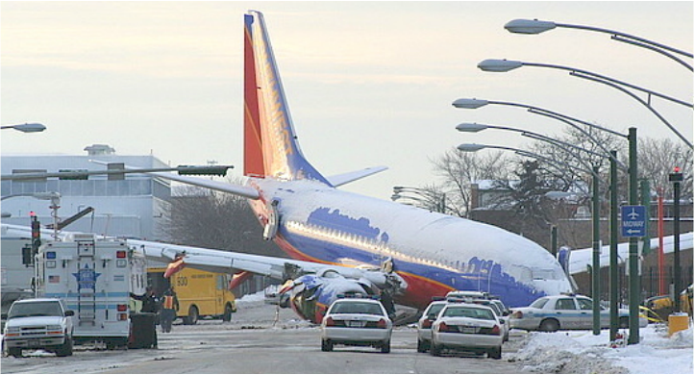
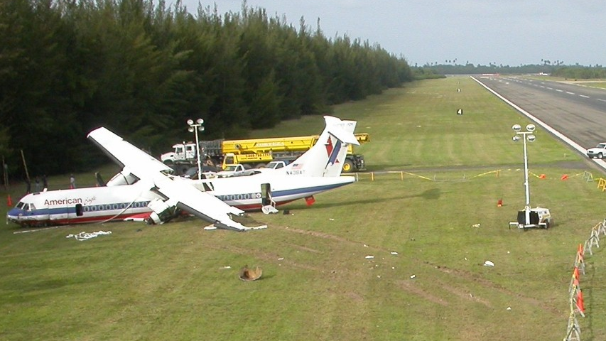
EMBRY-RIDDLE
AERONAUTICAL UNIVERSITY
College of Aviation
Role of Pilot Error and Crew Resource Management in Runway Excursion Accidents involving Part 121 Operators
Presented by: Albert Ma
Faculty Advisor: Professor Leo Murphy
Abstract
The purpose of this study was to research the role that pilot error and crew resource management play in runway overrun accidents during the landing phase of flight involving scheduled Part 121 Air Carrier operations in the United States. An inquiry to the National Transportation Safety Board’s Database indicated that 94 accidents involving scheduled Part 121 operators have taken place during the landing phase of flight and 30 of those accidents involved the aircraft departing the landing runway (runway excursion). According to our analysis, 83% of those accidents were a direct result of pilot error and 87% of those accidents could potentially have been avoided with proper crew resource management.
Results
25 of the total 30 accidents (83%) were a direct result of pilot error
26 of the total 30 accidents (87%) could have been avoided with appropriate Crew Resource Management techniques
Only 3 of the total 30 accidents cited Crew Fatigue as a contributing factor
Prior to the year 2000, most (77%) runway excursion accidents were committed by turbofan aircraft. However, after the year 2000, most (59%) accidents were committed by turboprop aircraft.
Introduction
According to a report published by the FAA, an estimated 70% to 80% of civil and military aviation accidents were caused by human error. As a result, the aviation industry has implemented numerous guardrails to prevent human error from resulting in accidents, such as implementing mandatory crew resource management training, enforcing checklist usage etc. For this research study, it is hypothesized that a significant number of these 30 accidents have probable causes relating to pilot error such as failing to maintain positive control of the aircraft or poor crew resource management. It is also hypothesized that a statistically significant number of these 30 accidents also have contributing factors such as fatigue. The FAA defines “pilot error” as an accident in which an action or decision made by the pilot was the cause or a contributing factor, and “crew resource management” as the effective use of all available resources: human, hardware, and information. This study is relevant for future investigations to reduce the number of accidents caused by pilot error and poor crew resource management.
Methods
All civil aviation accidents in the National Transportation Safety Board Aviation Accident Database involving Part 121 operators during the landing phase of flight were tabulated. Out of the 94 accidents that occurred during landing, 30 accidents involved a runway excursion. Every accident was examined and the probable causes were characterized using the SHEL Model, a conceptual model to better define the role of human factors in aviation and how they interrelate. The contributing factors of the accidents involving runway excursions were also examined for crew fatigue.
Discussions
Despite efforts to reduce the number of accidents resulted from pilot error or poor crew resource management, it is evident that especially during critical phases of flights such as take off and landings, more guardrails need to be implemented to reduce accident occurrences. This relates to the discussion of increasing the frequency of utilizing autoland functions in the future, if equipped, to prevent human error from taking place.
The increase in accidents involving turboprop aircraft in recent years could be due to airline expansion into smaller airfields with shorter runways and opens the opportunity for future research in this area.
References
Wiegmann, D. (2001). A Human Error Analysis of Commercial Aviation Accidents Using the Human Factors Analysis and Classification System. Washington, DC: Office of Aviation Medicine.
National Transportation Safety Board. (n.d). Aviation Accident Database & Synopses.
Retrieved from https://www.ntsb.gov/_layouts/ntsb.aviation/index.aspx
Reinhart, R. (2008). Basic Flight Physiology. New York, NY: McGraw-Hill.

