Slide 1
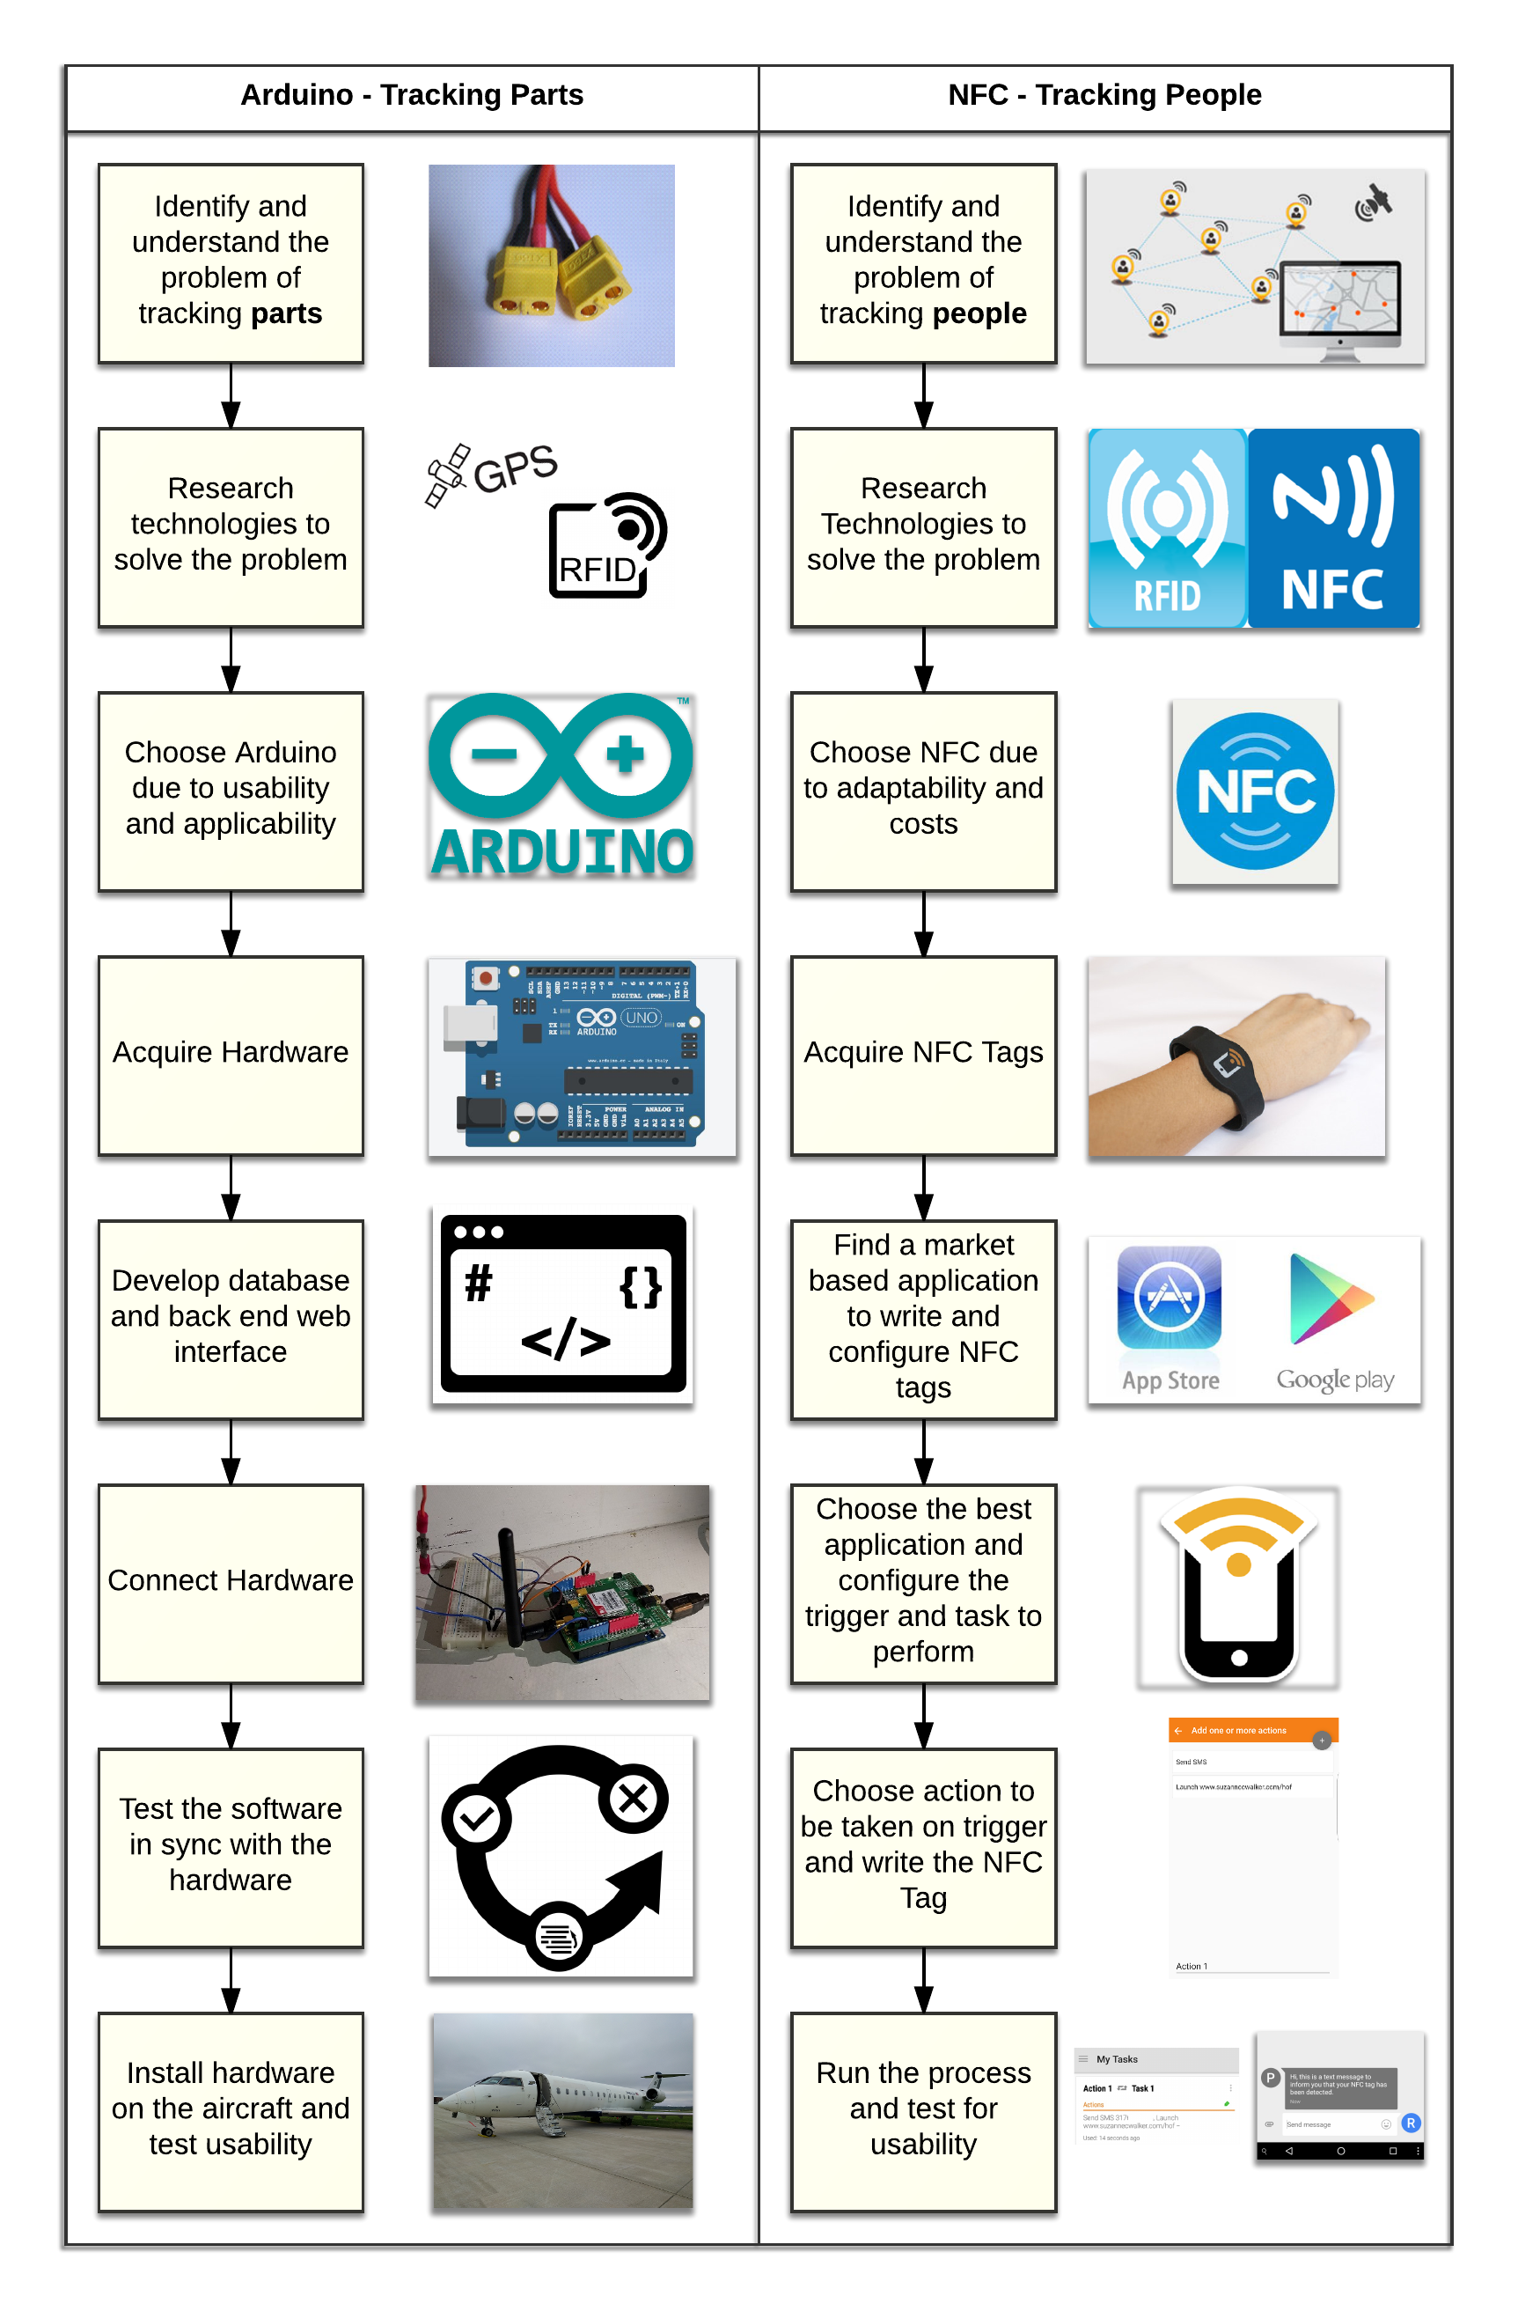
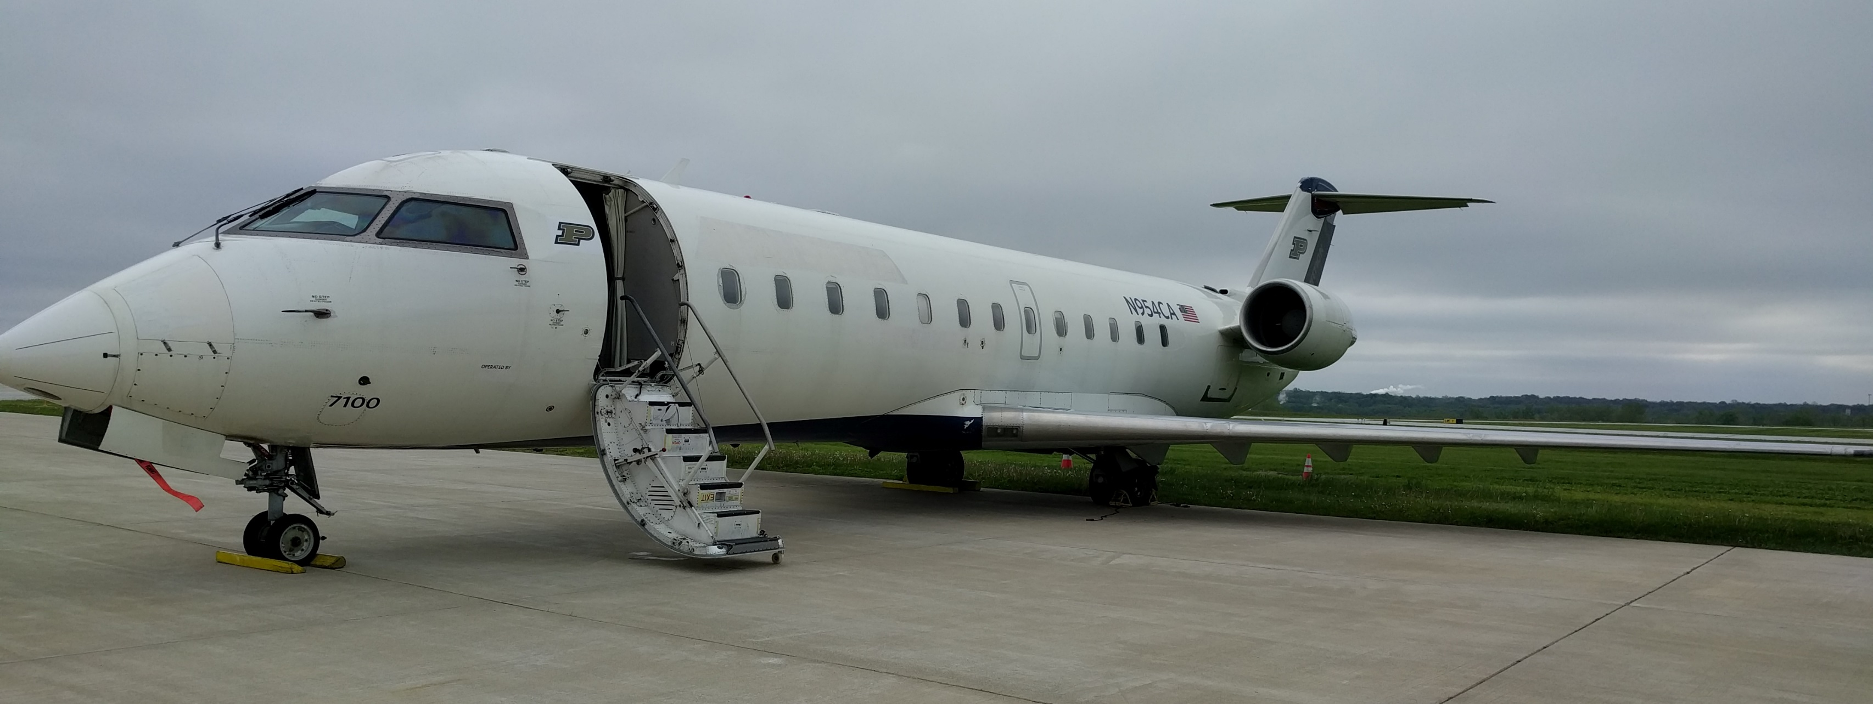
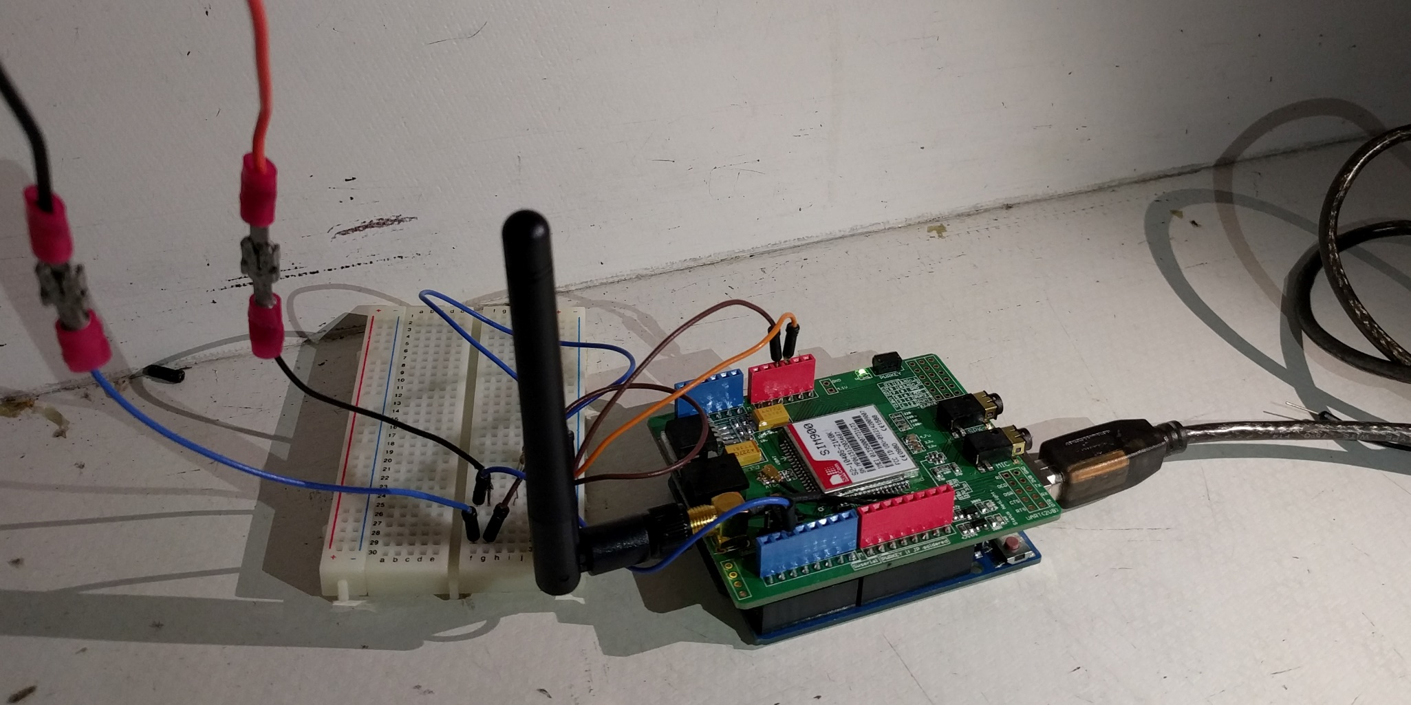
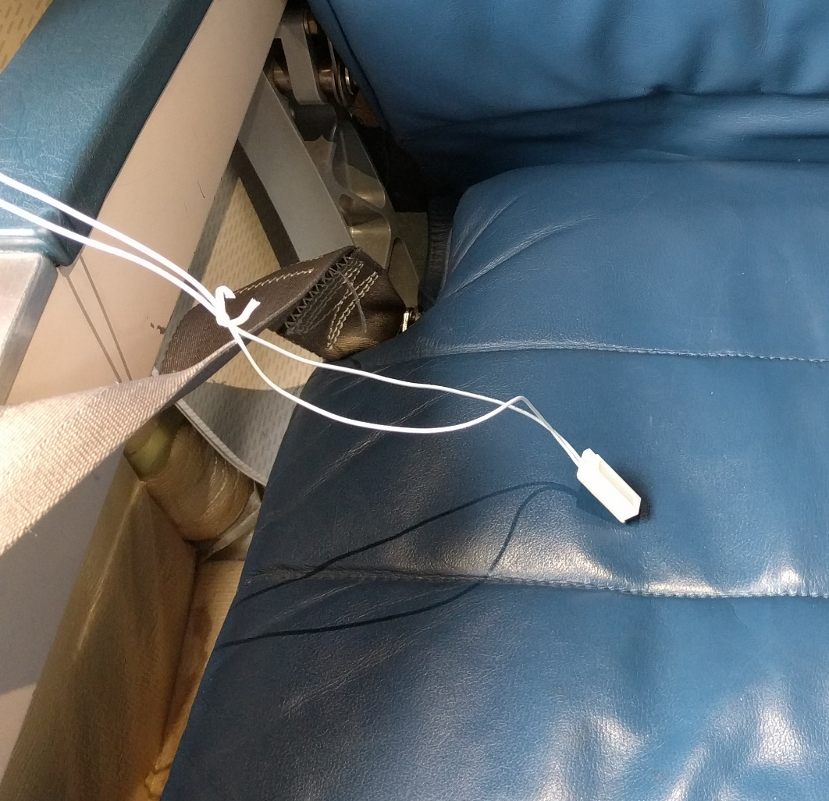
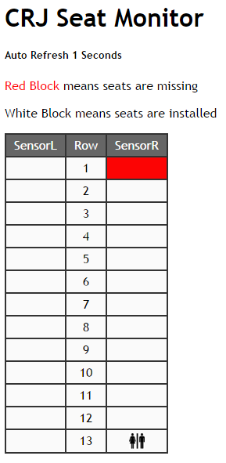
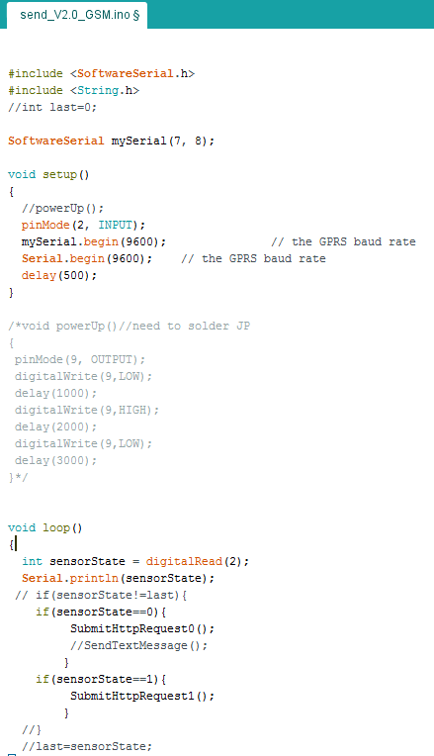
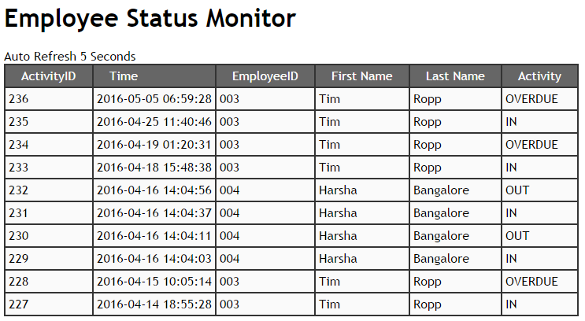
University Aviation Association
Transparency of People and Parts in an Aircraft during Maintenance
Rohit Burani, Kyle Jackson, Yiyiang Gu & Linfeng Jin
School of Aviation and Transportation Technology, Purdue University
Faculty Advisor: Mr. Timothy Ropp, SATT, Purdue Polytechnic Institute
Problem Statement
A problem exists in the current accountability and tracking of parts, people and maintenance items in the aft section of the Purdue CRJ-100
CRJ 100 – The aircraft used for this project
Technical Challenges
Tracking People
GPS is expensive
Complex system
Tracking Parts
Website content transfer
System setup such as bad contact
Network restrictions inside the aircraft
Approach
Tracking People
Possible ways: GPS, RFID, NFC
Tracking Parts
Possible ways: NFC, RFID, Arduino
Arduino setup over mobile network
Arduino cable attached to seat
The CRJ Seat Monitor based on input from the Arduino
over mobile network
An example of the Arduino
backend code for the seat
monitor as well as employee
monitor
The Employee Status Monitor
which includes a timestamp,
employee ID, name and the type
of activity that the sensor detects
Outcomes
Wearable NFC to tag in and out of the aircraft
Arduino with proximity sensor tracks part installation
Conclusion
Less than $200 spent
Complete people and parts tracking system
Permanent installation
Direct all correspondence about this research to: Mr. Rohit Burani (rburani@purdue.edu)

