Slide 1
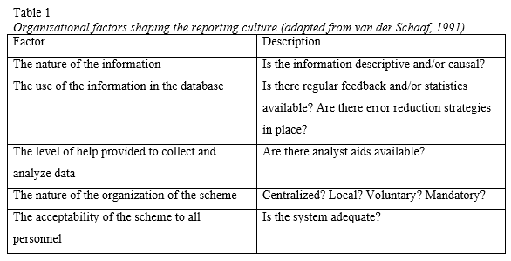


How to improve the reporting culture of bird strike related incidents:
A review of regulatory systems in the EU and North America
Lukas Rudari, Lauren A. Sperlak, Robert C. Geske, and Dr. Chien-Tsung Lu
Purdue University
Introduction
Bird strikes are a safety concern for both commercial and general aviation. Nevertheless, it is estimated that only 39 percent of all bird strikes occurring in the U.S are reported (FAA, 2012). It appears that the current culture for reporting such incidents is not supportive and retroactive in nature. (FAA, 2012)
This study first looks to investigate the different reporting systems currently in place by the various regulatory bodies around the world. Additionally, the researchers seek to identify areas of improvement in establishing a proactive reporting culture.
Bird strikes
The first known bird strike was in 1905, recorded by the Wright brothers. Wildlife hazards became a highly publicized topic when US Airways Flight 1549 lost both engines after ingesting a flock of geese and required a miraculous landing in the Hudson River.
It is important that flight crew is aware of the risk wildlife, particularly birds, pose. Bird strike damage is not only a tremendous safety concern but also a potential financial burden for organizations.
Abstract
One of the most common threats to aviation safety are aircraft encounters with wildlife, birds in particular. Wildlife strikes are not just a safety hazard but potentially costly as well. According to estimates by the FAA, bird strike related incidents cost the U.S. aviation industry almost one billion dollars annually. It is estimated that only 39 percent of all bird strikes are submitted to the FAA database in the United States; the remaining instances are not reported or recorded. There are a number of cultural factors hindering the establishment of an effective reporting culture, often attributed to organizational, regulatory, and national causes. The researchers provide recommendations for shifting from a reactive system to a more proactive regulatory reporting systems for wildlife encounters.
Discussion
One of the most common threats to aviation safety are wildlife encounters, particularly birds. Wildlife strikes are not just a safety hazard but can be costly as well. According to estimates by the FAA, bird strike related incidents cost the U.S. aviation industry almost one billion dollars annually. However, since it is estimated that only 39 percent of all bird strikes are submitted to the FAA database in the United States, the actual cost could be much higher. As there are an estimated 60 percent of unreported wildlife strikes, it can be argued that there are a number of cultural factors hindering the establishment of an effective reporting culture, often attributed to organizational, regulatory, and national causes. The researchers suggest shifting from a reactive system to a proactive regulatory reporting systems for wildlife encounters. Mandatory reporting systems in countries like Spain, France, and the United Kingdom have proven that systems like these can work and can be beneficial in understanding wildlife threats. However, even if the FAA implemented a mandatory reporting system, there is still room for improvement to fully transition from a reactive to a proactive reporting system. One recommendation for the future is to push for reporting of not just wildlife strikes but also near-miss encounters. This would allow researchers more data for use in tracking migratory patterns, nesting habits, and much more.
References
FAA. (2012). Wildlife Strikes to Civil Aircraft in the United States 1990-2011.
Van der Schaaf, T. W., Lucas, D. A., & Hale, A. R. (1991). Near miss reporting as a safety tool: Butterworth-Heinemann.
Pidgeon, N., O’Leary, M., 1995. Organisational Safety Culture:
Implications for aviation practice. In: McDonald, N., Johnston,
N., Fuller, R. (Eds.), Application of Psychology to the Aviation
System, England: Aubury, pp. 47–52.
Methods
A literature review was conducted to identify the regulatory systems regarding bird strike reporting in selected countries.
The researchers also identified relevant literature to first define the concept of “reporting culture” and consequently establish strategies for improvement.
Results
Reporting culture
Both organizational and personal factors influence the effectiveness of a reporting culture. Van der Schaaf (1991) defines five factors influencing the effectiveness of a reporting culture as shown above in Table 1. Being aware of these factors may be beneficial in the development of a successful reporting scheme. Pidgeon and O’Leary (1995) identified the fear of blame and legal consequences as possible reasons for the lack of reporting incidents in aviation.
Results
Regulatory systems
Table 2
US versus EU reporting systems
As the table above illustrates, the US (FAA) is the only country that does not require mandatory reporting. It should be noted that the type of reporting system (mandatory vs voluntary) is only part of the regulatory system. The need to provide additional information ie., access to the database, published reports, and bird identification, are equally important. The table above highlights that only two countries (US and UK) publish regular reports on bird strikes. Lastly, these same two countries are the only governing bodies that provide data on species identification.
The nature of the regulatory system and how it disseminates that information to the public is the most important element to increasing safety.
Reporting | FAA | Spain | Ireland | France | United Kingdom
On-line reporting | X | X | X | X | X
Dedicated website | X | X | X | X | X
Periodical publishing of reports | X |  |  |  | X
Voluntary reporting | X
Mandatory reporting |  | X | X | X | X
Public access to database | X | X | X |  | X
Bird species identification | X |  |  |  | X

