Slide 1
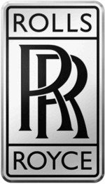
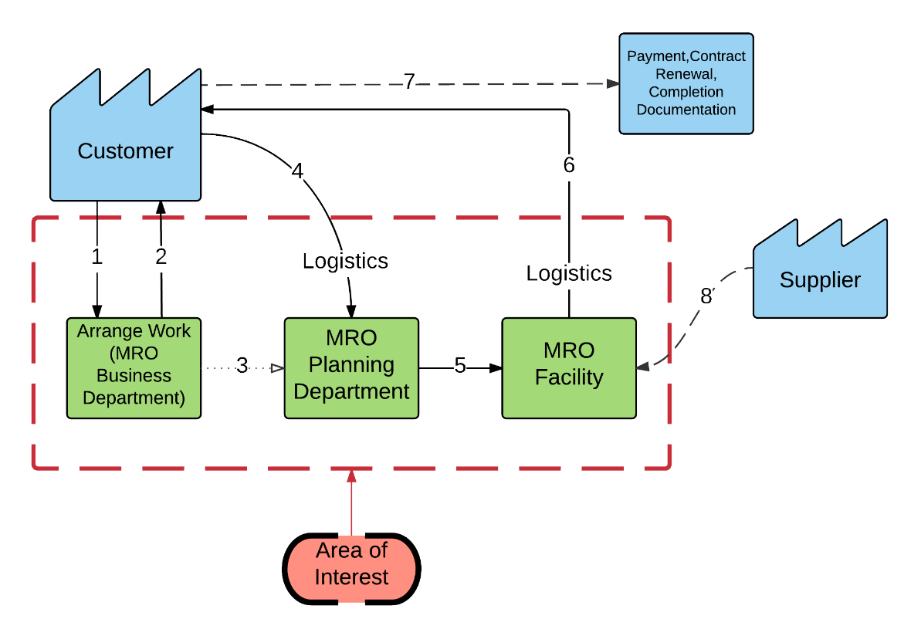
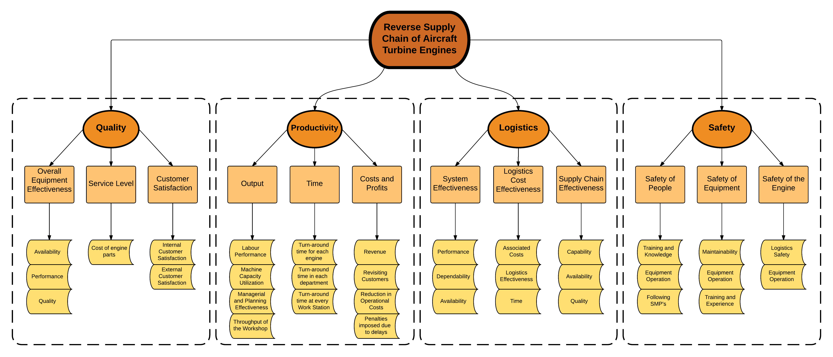
Quality and Productivity Measurement in Reverse Supply Chain Of Aircraft Turbine Engine: A Case Study of Trent 700 Engines
Ashitha Annamalai¹, Jacob ‘Joshua’ Shila², Rohit Burani²
1-Department of Technology, Leadership, and Innovation; 2-School of Aviation and Transportation Technology
Faculty Advisor: Dr. Mary Johnson, SATT, Purdue Polytechnic Institute
REVERSE SUPPLY CHAIN(RSC) OF ENGINES
Series of activities required to retrieve a used product from a customer and either dispose it or reuse it.
Aviation application of RSC would include maintenance and upgrade of aircraft engines coordinated between OEM/MRO and aircraft operators
OVERVIEW OF THE TRENT ENGINE
Trent 700 engines launched in 1995, specifically designed for Airbus A330. As of current Trent 700 has 58% market share for A330 aircraft
Rival engines for A330 include CF6-80E1 and PW4000 100-inch
MARKET OVERVIEW
Reverse Supply Chain is becoming an area of interest due to cost associated to MRO operations valuing at $45 billion a year hence second largest cost next to fuel consumption
OEM’s sell engines under ‘service packages’ agreements to enable them continue earning profits from MRO done to the engines
STEPS INVOLVED IN RSC
Product Acquisition
Reverse Logistics
Inspection and Disposition
Reconditioning
Distribution and Sales
CHALLENGES IN RSC
Delays cause significant loss to OEM and the MRO industry in general
Indirect costs or delays could also affect airlines due to aircraft being on ground leading to customer dissatisfaction
APPLICATION
Improved Quality of air transportation through financial savings and technical compliance in aircraft operations
ADVANTAGE
Better customer service
DRAWBACK
Cost control of materials and equipment
Measures
Factors
QUALITY
It is totality of safety and technical compliance of maintenance of engines to keep them airworthy and reliable
PRODUCTIVITY
It is the efficiency at which work is performed. i.e. It is the output of a given task to a given input
LOGISTICS
It is an important area within the RSC where performance of logistics operations directly affect Quality and Productivity
SAFETY
It involves policies and procedures in place to ensure the safety and health of employees within a workplace
QUALITY MEASURES:
Overall Equipment Effectiveness(OEE)
= (Availability) x (Performance) x (Quality)
Service Level
It is the probability of not getting the product on time
Customer Satisfaction
It includes Internal Customer Satisfaction which is satisfaction of people working in the company as well as External Customers
PRODUCTIVITY MEASURES:
Output$\text{=}\text{f}\text{(}\text{Labor} \text{Performance}\text{, }\text{Machine} \text{Utilization}\text{, }\text{Throughput}\text{, }\text{Mangerial} \text{and} \text{Planning} \text{Effectiveness}\text{)}$
Time=f[Average Turn around time of(each engine ,each department, individual work stations)]
Profitability=f(Revenue, Customer Satisfaction, Operational Cost, Costs due to delay)
LOGISTICS MEASURES:
Logistics System Effectiveness = f(Operational Performance, Dependability, Availability)
Logistic Cost Effectiveness = f(Logistics System Effectiveness, Logistics Costs, Time)
Supply Chain Effectiveness = f(Capability, Availability, Quality)
SAFETY MEASURES:
Safety of Engine = f(Logistics Safety, Operation of Equipment)
Safety of People = f(Training, Knowledge, Operation of Equipment, Following SMP)
Safety of Equipment = f(Maintainability, Operation of Equipment, Training, Experience)
Direct all correspondence about this research to: Mr. Rohit Burani (rburani@purdue.edu)

