Slide 1
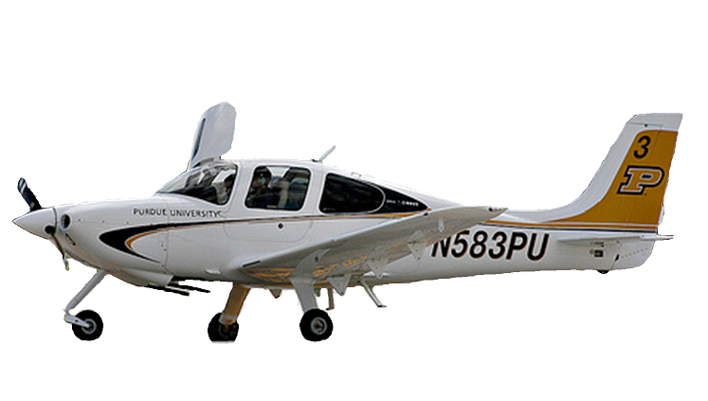
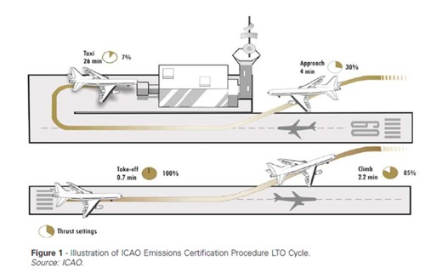
Air Transport Institute for Environmental Sustainability (Air TIES)
Purdue University
Aviation Technology
Landing and Takeoff Cycle Flight Data Processing
Matthew Prall
Dr. Mary Johnson
Faculty Sponsor
Abstract:
The purpose of this project is to analyze logged flight data to estimate fuel flow rates and times in mode for the landing and takeoff (LTO) cycle at the Purdue University Airport. Flight data is obtained from SIM cards from Cirrus SR20 aircraft within the Purdue University training fleet and processed using a MATLAB protocol. The MATLAB® script parses flight data to determine fuel flow rates and times in mode for each phase of the LTO cycle. Using a sample size of eight flights from the spring of 2014, a statistical analysis is completed for processed fuel flow rate and times in mode data. The analysis includes mean, standard deviation, and confidence intervals for each parameter. Time in modes and fuel flow rates are compared to the International Civil Aviation Organization (ICAO) and Emissions Dispersion and Modeling Software (EDMS) standards, respectively. Additionally, the investigation will determine sampling sizes for future studies and develop a sampling stratification plan.
Introduction:
Standard values for landing and takeoff cycle time in modes and fuel flow rates are given by the International Civil Aviation Organization (ICAO) (Figure 1) and the Emissions Dispersion and Modeling Software (EDMS), respectively. Previous studies have shown discrepancies between standard values and airport-specific values of a general aviation airport. Logged flight data can be used to validate and quantify the variation in values.
Results:
Time in mode (Table 1 and Figure 3):
Increased for takeoff, climb, and approach by 4.46%, 180.30%, and 30.36%, respectively
Decreased for taxi by 44.36%
Total time in mode decreased by 19.2%
Fuel Flow Rates (Table 2 and Figure 4):
Decreased for takeoff, climb, and approach by 54.36%, 36.60%, and 69.77%, respectively
Increased for taxi by 53.88%
Overall, fuel consumption (summation of fuel flow rate * time in mode for each LTO Operating Mode) decreased by 15.43%
Input:
Cirrus SR20 Flight
Output:
Time in Mode,
Fuel Flow Rates
Collect Flight Data
(SIM Card)
Extract Flight Data (CSV File)
Parse Flight Data (MATLAB® Script)
Question:
What differences in time in mode and fuel flow rates are found between logged SIM card data from Purdue University Cirrus SR-20s to standard ICAO and EDMS values?
Figure 2: Project Methodology
Large standard deviation and 95% confidence intervals show a great variation and lack of statistical significance of collected data
 | Fuel Flow Rate [kg/sec] |  | Time in Mode [min]
 | Standard Deviation | 95% CI | Standard Deviation | 95% CI
Take-off | 0.002839 | [0.0034, 0.0145] | 12.69913 | [0.3164, 1.1461]
Climb | 0.000692 | [0.0111, 0.0138] | 266.6051 | [-2.5424, 14.8758]
Approach | 0.001442 | [0.0031, 0.0088] | 178.2313 | [-0.6076, 11.0368]
Taxi | 0.000275 | [0.0012, 0.0022] | 225.0797 | [7.1141, 21.8193]
Table 3: Standard Deviations and 95% Confidence Intervals
Figure 1: ICAO Landing Take-off Cycle, Source ICAO
Methodology:
8 Cirrus SR20 aircraft flights during spring 2014 landing and taking off from Purdue University Airport (KLAF) used as study sample
Flight parameters logged on the aircraft’s SIM card throughout each flight
e.g.) engine RPM, latitude, longitude, ground speed, time, ect…
Data extracted from SIM card as a comma separated value (CSV) file
CSV file imported into MATLAB and parsed using engine and flight parameter based script
Time in mode and fuel flow rates generated as output from MATLAB script
Generated values from each flight compiled, analyzed for statistical significance, and compared to standard values
Figure 3: Time in Mode per LTO Operating Mode
Figure 4: Fuel Flow Rate per LTO Operating Mode
0 | ICAO Standard | MATLAB Estimate
LTO Operating Mode | Time-in mode [min] | Time-in mode [min]
Take-Off | 0.7 | 0.7313
Climb | 2.2 | 6.1667
Approach | 4.0 | 5.2146
Taxi/ground idle | 26.0 | 14.4667
Table 1: Time in Mode per LTO Operating Mode
 | EDMS Standard | MATLAB Estimate
LTO Operating Mode | Fuel Flow Rate [kg/sec] | Fuel Flow Rate [kg/sec]
Take-Off | 0.001122 | 0.008949
Climb | 0.019607 | 0.012430
Approach | 0.019607 | 0.005927
Taxi/ground idle | 0.019607 | 0.001727
Table 2: Fuel Flow Rate per LTO Operating Mode
Discussion:
SIM card data and analysis confirmed discrepancy between standard values and values collected from Cirrus SR20 flight data.
A greater sampling size (~25+ flights) would provide a better representation of the true
References:
International Civil Aviation Organization - ICAO, (n.d.). Local air quality. Retrieved from website: http://www.icao.int/environmental-protection/Pages/local-air-quality.aspx
Katsaduros, D., Prall, M., & Johnson, M. (2014). Exploration of Emissions Modeling for a General Aviation Airport. AIAA SciTech 52nd Aerospace Sciences Meeting. Retrieved from http://arc.aiaa.org/doi/abs/10.2514/6.2014-0013
nature of the LTO cycle and provide data of higher statistical value (decrease Standard deviation and confidence intervals).
Same MATLAB script can be used to collect SIM card data from Cirrus SR20 aircraft at similar general aviation airport and used to validate findings.
Notes:
UAA poster 2014

