Slide 1
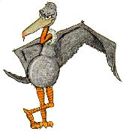
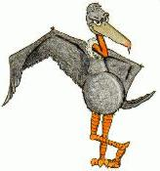
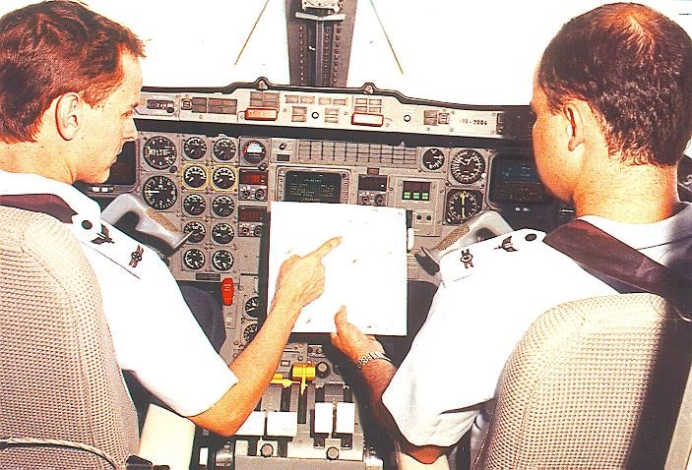
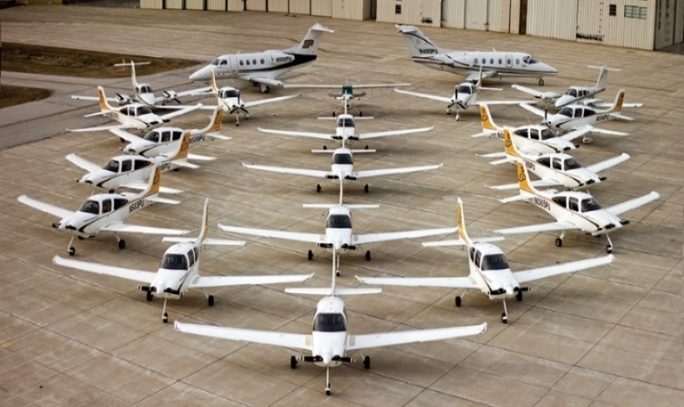
International Civil Aviation Organization (ICAO). (2003). Training guidelines for aircraft accident investigators (Cir 298 AN/172). Montreal, Canada: Author.
A Flight Crew Guide to the Mitigation of Bird Strikes to Aircraft: A Case Study
Flavio A. C. Mendonca – Ph.D. Candidate & Dr. Richard O. Fanjoy – Faculty Advisor
Purdue University
Abstract
a
Analysis of bird strikes to aviation in the U.S. from 1990 to 2015 indicate that the successful mitigation efforts at airports, which must be sustained, have reduced incidents with damage and had a negative effect-on-flight since 2000. However, such efforts have done little to reduce strikes outside the airport jurisdiction, such as occurred with a Cessna 500, registered as N113SH, that collided with large birds approximately two minutes after takeoff in 2008, in Oklahoma city. The investigation of this accident by the National Transportation Safety Board (NTSB) was profound, and showed that actions by the crewmembers could have mitigated the risk, probability and/or severity, of the wildlife strikes. A comprehensive review of major studies addressing the safety management of wildlife, the Federal Aviation Administration (FAA) Serial Report #22, the safety management systems (SMS) tenets, and the final report of the accident involving the N113SH was conducted. Results show that approximately 97% of the bird strikes to general aviation (GA) aircraft occur below 3,500 feet AGL (bird-rich zone), and that the aircraft airspeed is more critical than the bird mass in determining the probable outcomes of a bird strike. In addition, findings indicate that pilots can mitigate the risk of bird strikes through adequate flight planning, and the use of appropriate aircraft operating techniques while flying through the bird-rich zone.
Introduction
a
On March 4, 2008, a Cessna 500 collided with one or more American white pelicans at approximately 1,800 feet above
ground level (AGL) and 190 knots and crashed two minutes
after takeoff from Wiley Post Airport (PWA), in Oklahoma City.
a
Five people were killed, and the aircraft was destroyed by the impact forces and a post-crash fire. An investigation by the NTSB concluded that both the FAA Airport Facilities Directory and the U.S. Air Force Bird Avoidance Model (BAM) had information about the risk of bird strikes at and around PWA. The NTSB also concluded that the kinetic energy (KE) resulting from the impact far exceeded the aircraft certification design (NTSB, 2009). The purpose of this study was to develop a flight crew guide that could be used by aviators to mitigate the risk of bird strikes. Even though it is practically impossible to eliminate the risk of bird strikes, crewmembers play a vital role in the accident prevention process (Eschenfelder & DeFusco, 2010).
Methods
a
The researchers applied a qualitative case study throughout this project. The unit of analysis of this case study was the N113SH final report. A thorough review of the final report of the N113SH accident, major studies addressing the safety management of wildlife, the SMS concepts, and the FAA Serial Report #22 was conducted. Then, using the MacKinnon’s (2004) study as a foundation, the researchers developed a guidance incorporating suggested strategies by previous scientific studies (Dolbeer, 2007; Dolbeer, Weller, Anderson, & Begier, 2016; Eschenfelder & DeFusco, 2010; Mendonca, 2016; Nicholson & Reed, 2011) that could be used by pilots to mitigate the risk of aircraft accidents resulting from bird strikes.
Discussion
a
Bird strikes killed 25 people and destroyed 37 aircraft from 1990 through 2015 in the U.S. During the same period, approximately 72% and 97% of the strikes occurred below 500 feet and 3,500 feet AGL, respectively. Incidents that occurred above 500 feet AGL, generally outside the airport wildlife hazard management jurisdiction, had a greater probability of causing damage to the aircraft (Dolbeer et al., 2016). The N113SH collided with one or more American white pelicans at approximately 1,800 feet AGL and 190 knots. This bird species, whose weight range from eight to 20 pounds, is common in central Oklahoma from March to May. On the day of the accident, both the FAA airport facilities directory and the BAM had information regarding the medium-to-high risk of bird strikes for the area and time of the mishap (NTSB, 2009). The severity of a bird strike depends primarily on the KE of the bird relative to the airplane. The equation KE = (½ mass) times (velocity squared) clearly reveals that the aircraft airspeed is more critical in case of a strike than the size (mass) of the bird. Therefore, the risk of an accident due to bird strikes is higher during the departure phases of flight, especially during the initial climb-out while the aircraft is flying through the bird-rich zone (below 3,500 feet AGL). The faster rotation of the engine and higher aircraft airspeed(s) during the departure phases of flight compared to arrival can explain these differences (Dolbeer, 2007). Yet, the higher risk of strikes associated with the multiple challenges pilots have to tackle after an engine failure explain the preponderance of hull losses following a strike during departure, such as occurred with the N113SH. No individual strategy, program, or tool has been developed that successfully mitigates bird strikes in every location. Therefore, an integrated approach, based on SMS concepts, which combines numerous techniques and includes pilots’ actions, is likely to be more effective (MacKinnon, 2004).
a
References
[1} Dolbeer, R. A. (2007). Bird damage to turbofan and turbojet engines in relation to phase of flight: Why speed matters. Bird and Aviation 2(7), 1-9. Retrieved from http://davvl.de/Voluenglisch/2007/Dolbeer.pdf
[2] Dolbeer, R. A., Weller, J. R., Anderson, A. M., & Begier, M. J. (2016). Wildlife strikes to civil aircraft in the United States: 1990–2015 (Serial Report Number 22). Retrieved from the Federal Aviation Administration website: https://www.faa.gov/airports/airport_safety/ wildlife/media/Wildlife-Strike-Report-1990-2015.pdf
[3] Eschenfelder, P., & DeFusco, R. (2010, August). Bird strike mitigation beyond the airport. AeroSafety World, 5(7). Retrieved from http://flightsafety.org/aerosafety-world-magazine/august-2010/bird-strike-mitigation-beyond-the-airport
[4] Federal Aviation Administration (FAA). (2017). Wildlife hazard mitigation. Retrieved from https://www.faa.gov/airports/ airport_safety/wildlife/
[5] MacKinnon, B. (2004). Sharing the skies manual – An aviation industry guide to the management of wildlife hazards. Retrieved from the Government of Canada, Transport Canada website: https://www.tc.gc.ca/eng/civilaviation/publications /tp13549-menu-2163.htm
[6] Mendonca, F. A. C. (2016). Exploiting science: Enhancing pilots’ safety training to reduce the risk of bird strikes. Paper presented at the 2016 Bird Strike Committee USA Meeting, Chicago, IL. Presentation retrieved from https://www.aaae.org/ aaae/AAAEDocs/ Meetings/2016/08/160807/Pres/26_Mendonca.pdf
[7] National Transportation Safety Board (NTSB). (2009). Crash of Cessna 500, N113SH following an in‐flight collision with large birds - Oklahoma City, Oklahoma (NTSB/AAR-09/05-PB2009-910405). Retrieved from https://www.ntsb.gov/investigations /AccidentReports/ Reports/AAR0905.pdf
[8] Nicholson, R., & Reed, W. S. (2011, July). Strategies for Prevention of bird-strike events. BOEING Aero Magazine, 3(11). Retrieved from http://www.boeing.com/commercial/ aeromagazine/articles/2011_q3/4/
a
Contact
a
Direct all correspondence about this research to Flavio A. C. Mendonca, Purdue University.
Email: FMENDONC@PURDUE.EDU
Results
a
Pilots should anticipate hazardous conditions and take the necessary actions to mitigate safety risks, including wildlife hazards. There are several sources of aeronautical information that could be used by aviators in order to mitigate the risk of bird strikes, including the aeronautical information manual (AIM), notice to airmen (NOTAM), the FAA airport facility directory, and the BAM. After gathering information, flight crews should be aware and consider during all phases of flight (including flight planning) that the risk of an engine ingestion is higher during the departure phases of flight, the risk of damaging strikes is higher above 500 feet AGL, the probability of a strike is higher while flying through the bird-rich zone, and that the aircraft airspeed (and power-setting) is more critical in case of a strike than the mass of the bird. The table below depicts flight techniques that could be used by pilots as a strategy to reduce the risk (R), probability (P) and/or severity (S) of strikes.
Review available information on the risk of bird strikes related to the entire flight (R);
Plan the flight to operate above the bird-rich zone as much as possible during the entire flight (P);
Use speeds and flaps settings that provide the best angle of climb speed during initial climb-out (P);
Reduce flight time in the bird-rich zone (P);
Reduce airspeed while in the bird-rich zone (S);
Reduce engine power in the bird-rich zone if operationally
possible (S);
Use the aircraft external lights, especially the landing lights,
while flying in the bird-rich zone to enhance the detection of the aircraft by certain bird species (P);
8. Pull up if encountering birds, consistently with adequate flying techniques (P);
9. Listen to air traffic control to obtain up-to-date information on bird hazards (R);
10. Plan descent and approach in order to minimize flight time and airspeed while in the bird-rich zone (R);
11. Descend with minimum power and avoid low-altitude level flight if operationally possible (R); and
12. Consider a go-around if birds are encountered, but only if the go-around can be initiated without striking
birds after power is increased (S).
a
Pilots should report wildlife strikes following the FAA (FAA, 2017) guidelines. The reporting of wildlife strikes is vital for the accident prevention process. Some situations, such as a bird
ingestion during or just after takeoff, will probably require an immediate
crew response using standard operating procedures (SOPs). However, as
identified by the NSTB (2009) during the investigation of the N113SH accident,
there is usually sufficient time prior and during a flight for pilots to gather
information, analyze hazardous situations that may occur, assess the risk, reach
a decision, and then take the adequate actions.
Flight Crew Guide
Simulation-based illustration of the N113SH accident.
Source: NTSB 2009.

