Slide 1
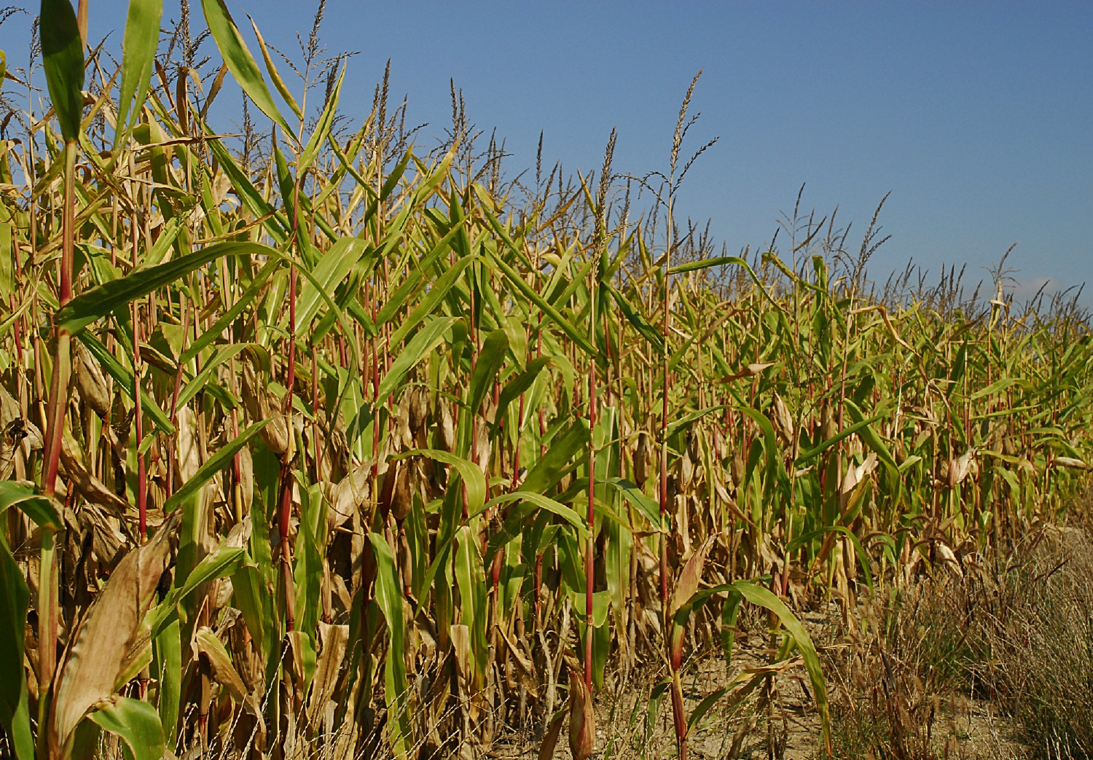
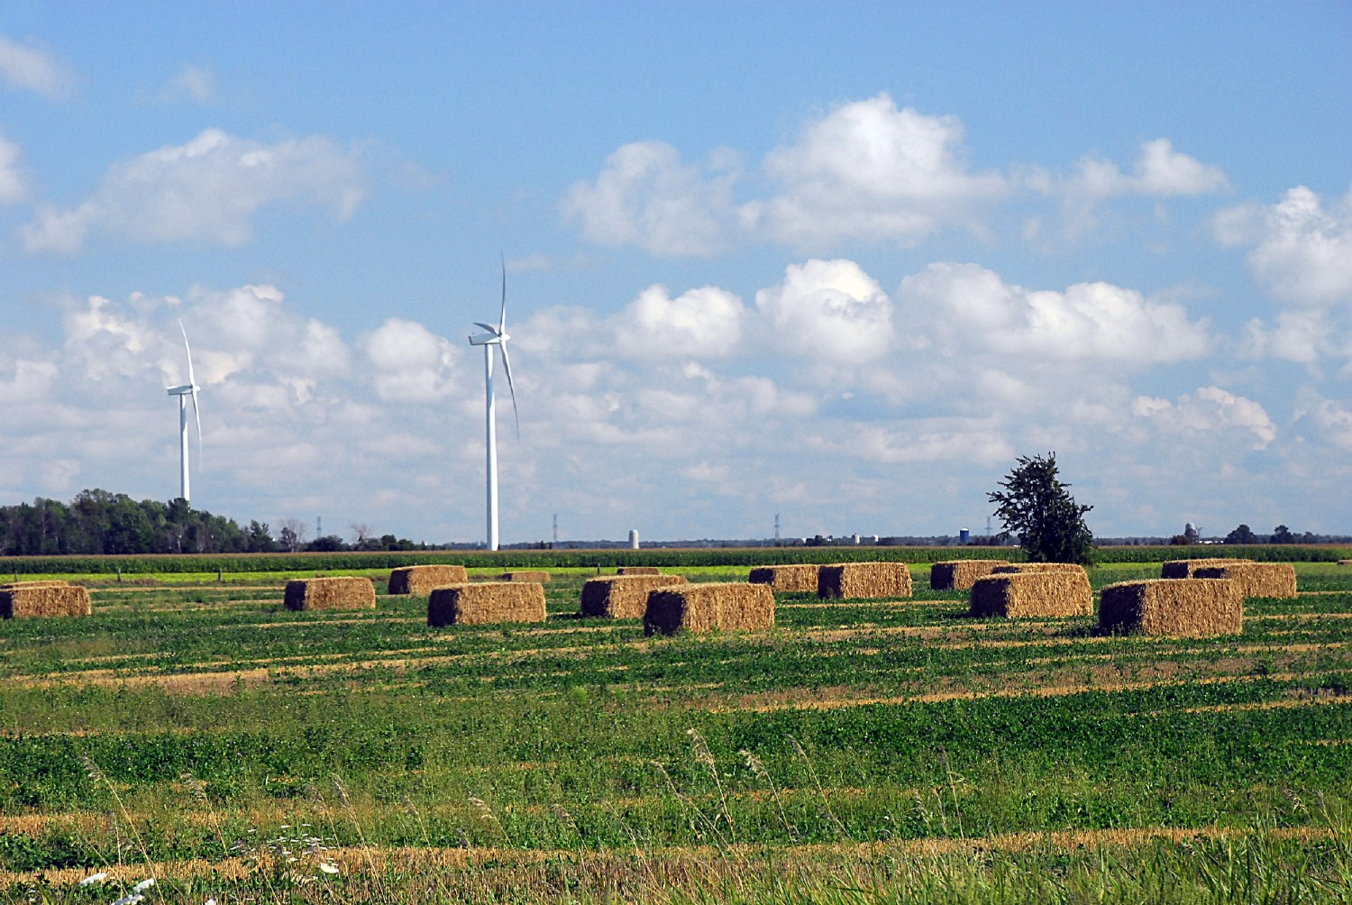
Agricultural UAS Policy and Issues by Pierre L. Laporte Embry-Riddle Aeronautical University Faculty advisor: Brent A. Terwilliger, Ph.D. Program Chair-M.S. in Unmanned Systems College of Aeronautics, Worldwide Embry-Riddle Aeronautical University, Orlando, FL
Image courtesy of FreePhotsandArt.com
Image courtesy of FreePhotosandArt.com
Abstract
This is a case study of UAS policy and its’ impact on the US agriculture industry and limits the review to agricultural use only. While the public primarily associates UAS with military operations UAS are used extensively in contexts beyond the military. In terms of productivity a promising area is the agriculture industry where unlike military applications the US lags behind the European Union (EU) and Japan. The chief concerns of commercial UAS use are privacy and safety. Federal Aviation Administration (FAA) policy prohibits, under many circumstances, commercial use of UAS and model aircraft; however, under FAA proposed rule (NPRM) Operation and Certification of Small Unmanned Aircraft Systems, the FAA intends to allow commercial use of small UAS. Agricultural use UAS fly primarily over uninhabited fields where privacy issues are not relevant and there is minimal likelihood of personnel injury in the event of an accident. Development of agricultural UAS technology has the potential to revolutionize management of large farms. Due to current costs the benefit to smaller farms is not expected to be as significant but I speculate that this could change as UAS costs drop. Resolution rests in easing the commercial ban or eliminating the commercial agricultural use ban while continuing the decision process on other uses. The FAA’s recently issued NPRM seeks to amend current regulations and continue the process of integration of sUAS and micro-UAS into the NAS however, due to the proposed weight restrictions the NPRM will not significantly enable UAS crop dusting. Pending final FAA determination regarding commercial UAS use agricultural UAS technology in the US will continue to lag behind Japan and the EU.
Introduction
This document contains an explanation of commercial agricultural UAS policy and its’ impact on the US agriculture industry and those affected, both directly and indirectly, an unbiased overview of the current operational and regulatory activities and environments, and proposes recommendations or alternatives. Due largely to a tremendous investment and use of unmanned aircraft systems (UAS) by the United States military the United States has become the acknowledged leader in UAS technology and deployment (Roberts, 2013; Shane, 2011; Singer, 2012). While military use brought UAS to the forefront and made the word “drone” a household word, UAS have been used in various forms and purposes for decades (Nicas, 2014). UAS have been used for entertainment industry photography, land surveying, search and rescue, animal nuisance control, fire fighting, animal and environmental conservation research, law enforcement, offshore oil field inspection, and agriculture (Hackman & Albanesius, 2013).
Methods
A qualitative and historical research methodology is employed. Extensive literature reviews are conducted. This document is directed to potential changes in policy, results are based upon extrapolations of similar policies in use in other countries and calculated speculation of achievable results based on existing technology, and current and proposed regulatory environments. Informed observations are included which are based on available research and the author’s interpretations thereof. An analysis of agricultural use, primarily crop dusting, in the United States and specifically the current regulatory climate that largely prohibits their commercial use is conducted.
Problem Statement
The fundamental problem with the current regulatory environment is that American farmers believe these restrictions collectively cost them billions of dollars in unrealized cost savings and net revenue (Garland, 2014; Green, 2013). It has been hypothesized that employing UAS for crop dusting could yield a one percent savings in operating costs and net a one percent (1%) increase in annual crop production (Green, 2013). The US Department of Agriculture (USDA) calculated that in 2012 agriculture and related industries added over $775 billion to the US gross domestic product (GDP) with close to $167 billion or one percent (1%) of the GDP coming directly from farms (USDA, 2014.).
Discussion
In 1983 the government of Japan solicited Yamaha Motor Company to develop an unmanned helicopter for fisheries and agricultural use (Hanlon, 2004). Much of Japan’s rice fields are on challenging terrain and labor is costly (Hanlon, 2004). The cost of using unmanned aircraft to conduct fisheries research and crop dusting was estimated to be approximately 10 percent that of a human labor and manned helicopters (Hanlon, 2004). Yamaha responded with the R-50, the first purpose built crop-dusting UAS capable of carrying a 20-kilogram payload (Hanlon, 2004). The R-50’s replacement, the RMAX has been a huge success for Yamaha, the government of Japan, and the agriculture industry with approximately 2,500 RMAX operational in Japan today and UAS responsible for crop dusting approximately 40 percent of Japan’s rice crop (Spence, 2013).
Agricultural Affect
UAS use for agricultural crop dusting directly affects two groups and indirectly affects a third. The two groups directly affected are the American famer, second and the crop duster pilots. The third and indirectly affected group is the American consumer.
The farmer. The most obvious affect to the farmer is the potential for cost savings. A farmer in Iowa can expect pay up to $25.00 per acre for aerial crop dusting services (Wilde, 2010). Due to the current FAA restriction on commercial use, UAS crop dusting is not legal in the US therefore it is difficult to estimate the cost differential but an attempt at cost comparison will be made nonetheless. Using a hypothetical 400-acre Iowa farm at $25.00 per acre would yield a crop spray price of $10,000.00. Using the Japanese government’s cost savings figure of 90 percent, the cost of crop dusting in this case would theoretically be reduced to $2.50 per acre for a cost savings of $9,000.00 per spraying or a net price of $1,000.00 for the same spray. Using an admittedly arbitrary 50 percent cost reduction figure would net a savings of $12.50 per acre for $5,000.00 for the same example.
The use of agricultural UAS however, is not limited to crop-dusting. Another promising area for farmers is land surveying. Stu Ellis, organizer of the Precision Aerial Ag Show in Decatur, Illinois stated that it would take approximately four to five hours to walk a an 80 acre field whereas a UAS could complete the same task in one half hour (Drones hit roadblock, 2013). Applying this to our hypothetical 400-acre farm is not reasonable as it is highly unlikely someone would walk a 400-acre area. The survey in this case would be done by air. A company in Maryland has stated it can provide agricultural UAS aerial survey for a cost of approximately $1.50 to $2.00 per acre as opposed to $8.00 per acre for a manned aerial survey (Pilots, n.d.). Again using our hypothetical 400-acre farm the cost difference is substantial. Using the high estimates a manned survey would cost $3,200.00 dollars as opposed to a UAS survey at $800.00 or one fourth of the manned cost.
Pilots. The second directly affected group is the crop dusting pilots. Crop dusting pilots can earn an average annual salary in excess of $60,000.00 per year with some making over $100,000.00 per year (Pilots, n.d.). Transitioning to an unmanned industry would cost many of these pilots their jobs and would require them to transition to either different flying positions or new careers altogether. This is a normal affect of technology outpacing an industry. Witness the telecommunications industry, where automated switchboards have all but entirely replaced the human telephone operator (The Associated Press, 2013).
Another area where pilots are affected is in safety. Crop dusting is an inherently dangerous form of flight. 141 crop dusting pilots have been killed in a 10-year period (Pilots, n.d.). In the event of an accident, such as striking a tree or barn, a crop dusting UAS will fall harmlessly to the ground whereas the same accident with a manned aircraft could result in a fatality.
The Public. While the direct impact of this issue is to the American farmer and the pilots there may be an indirect impact to the American consumer. There is no guarantee that cost savings resulting from UAS crop dusting or agricultural purposes will be passed to the consumer. The cost savings may be simply absorbed as increased operating profit however, were the projected one percent (1%) cost savings passed on to the consumer the average American could save $78.00 to $93.00 per year in groceries (Mendez, 2012).
Current Regulatory Environment
USA. The FAA currently prohibits most commercial use of UAS in the United States. Organizations and individuals desiring approval to commercially operate UAS in the NAS have two options according to the FAA:
There are currently two ways to get FAA approval to operate a UAS. The first is to obtain an experimental airworthiness certificate for private sector (civil) aircraft to do research and development, training and flight demonstrations. The second is to obtain a Certificate of Waiver or Authorization (COA) for public aircraft. Routine operation of UAS over densely populated areas is prohibited (Unmanned aircraft systems, 2014, para. 6).
The FAA’s recently announced NPRM which will allow the commercial use of small UAS, under 55 pounds, in restricted instances similar to those of model aircraft; the primary stipulations are remaining under 500 feet above ground level (AGL), no manned pilot training required, no operations over uninvolved personnel, and flight must within line of sight of the operator (Whitlock, 2015). The under 55 pound stipulation all but eliminates use of UAS under these guidelines for crop dusting however, it does enable other agricultural uses.
The FAA has enacted privacy regulations that have in effect placed the FAA in a de facto privacy regulating status regardless of their stated position to the contrary (Bennet, 2014). Although it is speculation as to if these policies will be expanded, continued, or discontinued after the initial test period, they exist nonetheless.
Japan. As previously noted, UAS are in wide use in Japan for crop dusting and other agricultural purposes. The Japanese Ministry of Agriculture, Forestry, and Fisheries has embraced UAS as a safe and economically viable method of reducing costs and minimizing labor (Hanlon, 2004). Only agricultural UAS in Japan are regulated with no definitive regulations outside of such (Dalamagkidis, et al., 2012).
EU. UAS are used throughout the European community and regulations are varied and inconsistent. However, the European Aviation Safety Agency (EASA) has been working on the development of unified and consistent safety standards. These new standards will require approval by European member states and the European Parliament and implementation is anticipated sometime in 2016 (PE, 2014).
Concerns
Safety. The FAA states that their primary mission is safety (Unmanned Aircraft Systems, 2014). As noted, crop dusting accidents have resulted in 141 pilot fatalities during the past 10 years (Pilots, n.d.). Most crop dusters are single seat aircraft and as such the fatality is, in all cases noted, the pilot. By virtue of not having a pilot in the cockpit the concern for pilot safety is eliminated. An argument being posed by some UAS proponents is how can the FAA state that safety is a priority yet a recreational, i.e. not for business activity, UAS flight is allowable but the same flight in a for profit scenario is not (McNeal, 2014).
The same discussion points relating to the unpopulated nature of the proposed operating areas for agricultural UAS are germane to the safety discussion. Scientist calculate there is a 1 in 11 million chance of being killed in a plane crash, there are no statistics available to quantify the chances of being killed by a crashing plane or UAS (Roper, 2008). Assumption, the UAS would be operating in unpopulated areas so there is very little likelihood of a crashing UAS striking a human.
Privacy. Many Americans cite privacy as a chief concern of widespread UAS usage (Hayward, 2014) fearing an unmanned camera peering into their home and, perhaps inadvertently as recently happened in Seattle, violating their privacy (Provenza, 2014). Although this concern has been enhanced by frequent media coverage of high powered military UAS taking long range photos of adversaries in combatant locales I doubt few would argue that it is still a valid concern in urban or other populated environments. The subject of this document however is agricultural use and in that context the privacy concerns become less relevant.
The intent of agricultural UAS is to apply pesticides and survey or perform other functions over agricultural lands, specifically farmland and ranchlands. By nature of the desired use and the area of usage, with the exception of persons working in the field at the time of UAS over flight, there are no privacy issues with which to contend. Additionally, for safety reasons, personnel are not in the fields during dusting operations. When taking the operations and areas into consideration it becomes difficult to speculate and impossible to quantify how privacy concerns can be considered as a roadblock to agricultural UAS use.
Security. Some are concerned that that a proliferation of UAS may lead to masses of armed UAS roving the skies however current law prohibits arming of civil aircraft (Hayward, 2014) so consequently illegally arming a UAS would be and is a crime. There are no indications that the FAA is considering changing this regulation. The implications of lawfully armed UAS operating in the NAS are beyond the scope of this document.
Cost. Throughout this document, when specific data was available to allow for direct comparisons, the cost of operating a UAS is compared to the alternative manned flight option were are presented. However, given the current regulatory environment and the inherent inaccuracy of using foreign values for US cost comparisons these estimated costs must all be considered suspect. It is in many cases extremely difficult and in some cases impossible to perform valid one to one comparisons and numerous factors affect the cost of UAS operations, often more so than manned aircraft. Some of these factors include:
Own UAS or lease UAS service
Owner operated or contract operated
Size of UAS
Size of agriculture operation
Level of technology required to achieve desired end result refinement
Geographic location
It is however a fair statement to say that UAS operating costs tend be substantially less than manned flight costs. In the AUVSI article “ Are UAS More Cost Effective than Manned Flights”, Chris Mailey (2013) provides several examples of actual Bureau of Land Management (BLM) cost comparisons for three projects. Though these projects were not agricultural in nature they provide a relevant cost perspective:
1. Mesa County, Colorado landfill inspection:
Contractor manned cost - $10,000.00
Government unmanned cost - $300.00
2. Mesa County, Colorado gravel pit inspection:
Contractor manned cost - $10,000.00
Unmanned cost - $120.00
3. Sandhill Crane population survey
Government manned cost - $4,300.00
Contractor manned cost - $35,000.00
Unmanned cost - $2,600.00
Unmanned aircraft were operated by BLM or other government staff. Government costs reflect only direct costs and present an actual, not hypothetical, cost comparison scenario.
Alternative Actions
There are several alternative actions possible to resolve the issue of the current status of FAA regulations as they relate to prohibiting the commercial use of UAS in agricultural operations. The resolution of this issue rests primarily with the FAA and Congress, as they are the legislating and regulating bodies. Local and state jurisdictions can pass laws on a local level however, responsibility for the NAS rests with the FAA, and therefore they ultimately determine the national policy.
The FAA has recently announced that it will soon provide a ruling on the commercial use of small UAS, under 55 pounds, in the NAS (Tajdeh, 2014). Though no specifics were provided, the FAA has indicated the changes will significantly ease the barriers to small commercial UAS operation (Tajdeh, 2014).
Recreational equivalent policy
The FAA can simply allow commercial use of UAS under the same guidelines currently allowed for recreational use, eliminating the business use clause. The advantage to this option is that is simple, easily implemented, and understood by the intended audience and there is very little true cost to the government. The current FAA recreational use guidelines prohibit, among other things, flying near airports and above 400 feet so interference with commercial and most general aviation traffic is virtually non-existent (Unmanned Aircraft Systems, 2014). Due to the rural nature of agriculture these restrictions are rarely of impact to farmers and ranchers. Many UAS potentially used in the agriculture industry for other than crop dusting would fall into the under 55 pound category. Crop-dusting UAS, by virtue of payload weight alone would speculatively not benefit from any change in the small UAS ruling. This is the key negative aspect to this option.
Comprehensive policy
Another potential option for the FAA is to not move forward separately on the agricultural UAS use issue but rather include agricultural UAS regulation as part of a comprehensive UAS policy. This appears to be a logical approach. The benefit is the avoidance of additional administrative burdens to the government by developing separate rules that will need to be monitored and implemented separately. Additional administrative burdens create additional administrative costs so from a purely economic standpoint the idea has merit.
The negatives of this approach are that based on comments by Jim Williams, FAA UAS Integration Manager, UAS flight restrictions in the NAS will not be lifted by 2015, changes will be made, but it will be a piecemeal process 2015 (Tajdeh, 2014). This indicates that full integration could yet be a long time off. Regarding the cost aspect of this issue, this approach will prolong the potential negative financial impact to the farmer as well as continuing to delay technological innovation and research in this field.
Recommendations/Results
Resolution of the FAA restriction lies in a hybrid approach to regulation. Public safety, including all users of the NAS must remain paramount however, it must be viewed in a realistic context. The FAA must first examine the actual need by asking some key questions:
What exactly are the farmers asking for?
Why are they asking for it?
What are the specific types of UAS necessary to accomplish these goals?
Once the above has been determined there needs to be a follow on set of questions:
What type of training is required to safely operate the needed UAS?
Depending upon the complexity of operation, what type of licensing is required, if at all? There is not a one-size fits all answer to this question as different UAS may require different certification.
Who should the governing body be? Is this something that should be handled by the department of agriculture within FAA guidelines?
The farming community must share responsibility in process by forming a self-governing body to provide a uniform recommendation to the FAA for policy and procedure. This has worked very well for the model aircraft community with the Academy of Model Aeronautics (AMA).
Safe integration of UAS into the NAS for agricultural purposes can be accomplished by:
Implementing tiered rules for various sized UAS. Hand launched UAS used for aerial photography and mapping with limited flight durations and limited performance capabilities should not be grouped with larger UAS capable of sustained flight at altitudes exceeding 400 feet. Size is not the only determining factor. The Yamaha RMAX although 9 feet long has line of sight control and a working altitude of only five meters in the crop dusting version and 100 meters in the aerial photography version (Hanlon, 2014).
Using the current model aircraft requirements as a starting point establish operator requirements based on system complexity and potential for damage in the event of an accident.
Conclusions
Lack of commercial use UAS regulation is hindering technological development of agricultural UAS and costing the American farmer billions of dollars in lost or unachieved productivity as well as potentially negatively impacting American consumers. While updated regulations are forthcoming there is no clear indication as to the effectiveness of these regulations and there is a clear likelihood that these changes will not yet impact the crop dusting segment of agricultural UAS. Potential solutions may be forthcoming through regulatory decisions by the FAA however; the solution to the problem rests with a joint effort of the American farmer and the FAA working together to move agricultural UAS forward while maintaining the safety of the NAS and the general population.
References
Bennet, W. (2014). Civilian Drones, Privacy, and the Federal-State Balance.
Brookings Institution. Retrieved from
http://www.brookings.edu/~/media/Research/Files/Reports/2014/09/civilian
%20drones%20privacy/civilian_drones_privacy_bennett_NEW.pdf
Dalamagkidis, K, Valavanis, K. Piegl, L. (2012). On integrating unmanned
aircraft systems into the national airspace system (2nd ed.). New York:
Springer. doi: 10.1007/978-94-007-2479-2
Drones hit roadblock on path to become farming tool. (2014, July 27). Farming Drones. Retrieved from http://farmingdrones.com/drones-hit-roadblock-on-path-to-become-
farming-tool-business/
Garland, C. (2014, September 13). Drones may provide big lift to agriculture when FAA allows their use. Los Angeles Times. Retrieved from http://touch.latimes.com/
#section/-1/article/p2p-81352913/
Green, M. (2013, March 26). Unmanned drones may have their greatest impact
on agriculture. The Daily Beast. Retrieved from
http://www.thedailybeast.com/articles/2013/03/26/unmanned-drones-may-
have-their-greatest-impact-on-agriculture.html
Hackman, M., Alanesius,C., (2013). Beyond warfare: 12 non-lethal
uses for drones. PC. Retrieved from
http://www.pcmag.com/slideshow/story/307900/beyond-warfare-12-non-lethal-uses-for-drones
Hayward, J. (2014, April 21). Poll: Drones Are Scary. (Blog) Retrieved from
http://www.breitbart.com/InstaBlog/2014/04/21/Poll-Drones-are-scary
Hanlon, M. (2014). Yamaha’s RMAX – the worlds most advanced non-military UAV. Gizmag.com. Retrieved from http://www.gizmag.com/go/2440/
Mailey, C. (2013, October 24). Are UAS more cost effective than manned flights. AUVSI Hampton Roads. (Blog). Retrieved from http://www.auvsi.org/HamptonRoads/blogs/
chris-mailey/2013/10/24/are-uas-more-cost-effective-than-manned-flights
Mendez, E. (2012). Americans Spend $151 a week on food; the high-income $180. Gallup. Retrieved from http://www.gallup.com/poll/156416/americans-spend-151-week-
food-high-income-180.aspx
McNeal, G. (2014, July 11). Six things you should know about Amazon’s drones. Forbes. Retrieved from http://www.forbes.com/sites/gregorymcneal/2014/07/11/six-things-
you-need-to-know-about-amazons-drones/
Nicas, J. (2014, October 9). Why Some Drone Makers Hate the Word ‘Drone’ and Want to Change It. The Wall Street Journal. Retrieved from http://www.wsj.com/articles/why-
some-drone-makers-hate-the-word-drone-and-want-to-change-it-1412821801
PE. (2014). EU to regulate UAV usage. Institute of Mechanical Engineers. Retrieved from http://www.imeche.org/news/engineering/eu-to-regulate-uav-usage
Pilots. (n.d.). Retrieved from http://www.auvsi.org/content/DeadliestJobs/pilots/
Provenza, N. (2014, June 25). Man says his drone alarmed Seattle woman. The Seattle Times. Retrieved from http://blogs.seattletimes.com/today/2014/06/man-says-his-drone-
alarmed-seattle-woman/
Roberts, K. (2013). When the whole world has drones. National Journal. Retrieved from http://www.nationaljournal.com/magazine/when-the-whole-world-has-
drones-20130321
Roper, M. (2008). Scientist calculate odd ways to die. Mirror. Retrieved from http://ww.mirror.co.uk/news/weird-news/scientists-calculate-odd-ways-die-282884
Shane, S. (2011, October 8). Coming Soon: The Drone Arms Race. The New York Times. Retrieved from http://www.nytimes.com/2011/10/09/sunday-review/coming-soon-the-
drone-arms-race.html?pagewanted=all&_r=0
Singer, P. (2012). Inside China’s Secret Aresenal. Popular Science. Retrieved from http://www.popsci.com/technology/article/2012-12/inside-chinas-secret-arsenal
Spence, K. (2013). Northrop Grumman wants to sell unmanned drones to farmers? The Motley Fool. Retrieved from http://www.fool.com/investing/general/2013/12/08/
northrop-grumman-wants-to-sell-unmanned-drones-to.aspx
Tajdeh, Y. (2014). FAA Official: Small drone ruling to be released by end of year. sUAS News. Retrieved from http://www.suasnews.com/2014/11/32567/faa-official-small-
drone-rule-to-be-released-by-end-of-year/
The Associated Press. (2013, January 24). Can smart machines take your job? Middle class jobs increasingly being replaced by technology. Daily News. Retrieved from http://
www.nydailynews.com/news/national/smart-machines-job-article-1.1246522
United States Department of Agriculture Economic Research Service. [USDA]. (2014). Ag and food statistics: charting the essentials. Retrieved from http://www.ers.usda.gov/
data-products/ag-and-food-statistics-charting-the-essentials.aspx
Unmanned Aircraft Systems. (2014). Retrieved from https://www.faa.gov/uas/
Whitlock, C. (2015, February 15). FAA rules might allow thousands of business drones. The Washington Post. Retrieved from https://www.washingtonpost.com/world/national-
security/faa-releases-proposed-rules-for-domestic-drone-use/2015/02/15/6787bdce-b51b-11e4-a200-c008a01a6692_story.html
Wilde, M. (2010). Dusting crops a boon, necessity for farmers. Cedar Valley Business Monthly Online. Retrieved from http://wcfcourier.com/business/local/dusting-crops-a-
boon-necessity-for-farmers/article_a8b5380e-a64c-11df-9408-001cc4c002e0.html
Clipart courtesy of openclipart.com

