Slide 1
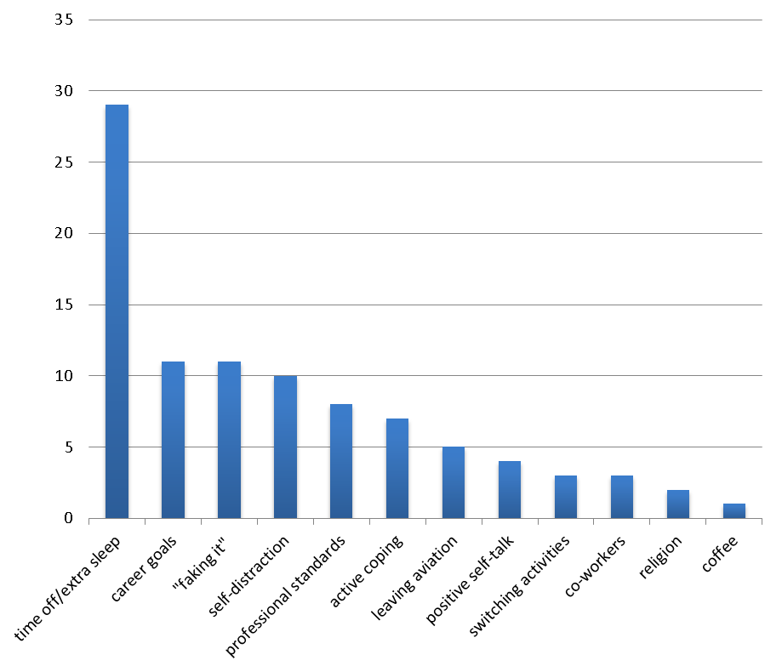
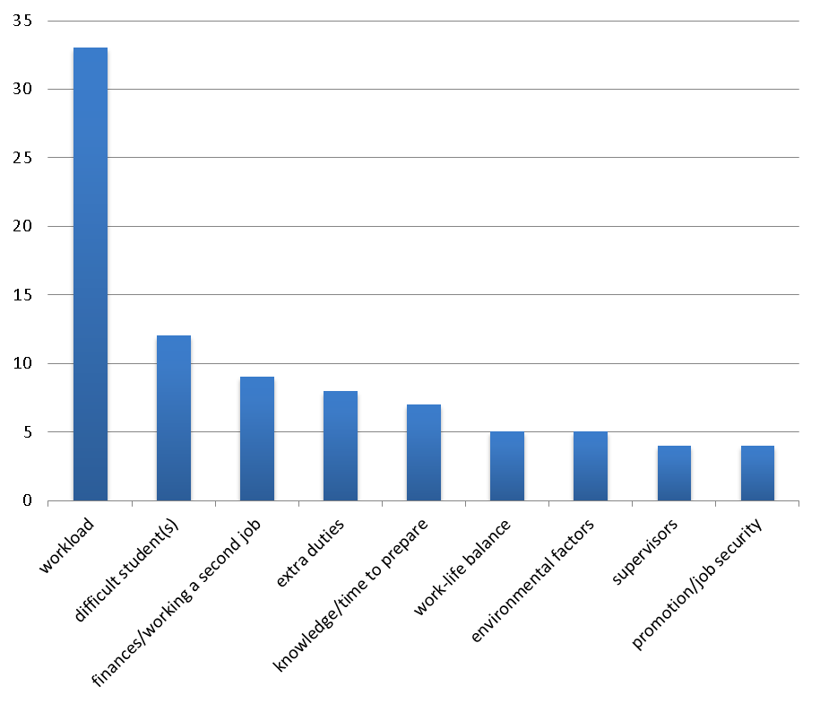
Stressors and Coping Strategies among Collegiate Flight Instructors
Jennifer E. Kirschner, Richard O. Fanjoy, Mihaela Vorvoreanu, Erin E. Bowen, and Thomas Q. Carney
Abstract
Particularly in high consequence industries such as aviation, stress is an important area of research because of the inverse relationship between stress and job performance. Increases in stress may cause a decrease in job performance. A decrease in job performance may have devastating or life-threatening impacts for passengers or crewmembers. Although stress is a common experience for all pilots, little research has been conducted into the causes of stress in flight instructors (McDale & Ma, 2008).
Stress is present in nearly all organizational contexts (Sonnentag & Frese, 2003), but job characteristics can make a particular job more inherently stressful than other jobs (Kelloway & Barling, 1991). The relationship between stress and job performance is typically hypothesized as being inverted (Muse, Harris, & Field, 2003). While some amount of stress is necessary and beneficial, too much can be detrimental to performance. Prolonged exposure to high levels of stress can impact employee health outcomes, increasing health care costs and absenteeism from work at a cost to employers of billions of dollars per year (Sonnetag & Frese, 2003).
The current research study contacted flight instructors working under the intensive flight training conditions found within collegiate aviation. The purpose of the study was to gather information about stressors and strategies for combating stress. Survey participants consisted of 89 full-time flight instructors employed by seven colleges and universities with AABI-accredited flight programs.
The most common stressors listed included a high workload, difficult students, finances/working a second job, and extra duties. Strategies listed for dealing with stress included taking time off from work or catching up on sleep, focusing on career goals, and surface-level acting.
Selected References
Bjerke, E. & Malott, D. (2011). Impacts of Public Law 111-216: Will the flight instructor career path remain a viable option for aspiring airline pilots? Collegiate Aviation Review, 29(1), 1 – 9.
Braun, V. & Clark, V. (2006). Using thematic analysis in psychology. Qualitative Research in Psychology, 3(2), 77-101.
McDale, S. & Ma, J. (2008). Effects of fatigue on flight training: A survey of U.S. part 141 flight schools. International Journal of Applied Aviation Studies, 6(2), 311 – 336.
Sonnetag, S. & Frese, M. (2003). Stress in Organizations. In W. C. Borman, D. R. Ilgen, & R. J. Klimoski (Eds.), Handbook of psychology (Vol. 12, pp. 453 – 491). Hoboken, NJ: Wiley.
Young, J. (2008). The effects of life-stress on pilot performance (NASA/TM–2008-215375). Moffett Field, CA: Ames Research Center.
Introduction
Background
High consequence industries are those with the potential for catastrophic accidents involving the loss of life or other threats to society. Aviation is one such industry because of the high degree of responsibility placed on the pilot to maintain the safety of flight. Flight instruction is a unique situation because of the simultaneous yet often competing demands of maintaining the safety of flight and providing quality instruction.
Significance of the Study
Increases in stress have been shown to have a negative effect on job performance. For pilots, this can translate to decreases in situation awareness, difficulty concentrating, and increases in fatigue and insomnia. Recent changes to airline hiring minimums may cause aspiring pilots to spent years working as flight instructors in order to build flight time (Bjerke & Malott, 2011), making this a very timely issue. It is not yet known what effect years of exposure to the stress caused by flight instructing will have on the population of flight instructors.
Purpose of the Study
Little is known about the stressors that impact flight instructors and the stress coping strategies that are used to counter the effects of stress. The current research study contacted flight instructors involved in intensive amounts of flight instructors in order to better understand the stressors they face and the coping strategies they use to deal with stress.
Research Questions
The current study sought to answer two questions:
What factors increase job stress?
What strategies are used to combat the effects of job stress?
Methodology
The topics of interest in the current study could be considered “sensitive information.” More so than professionals in other industries, pilots may be reluctant to report the effects of stress (Young, 2008) because of the potential for negative impacts on their flight status. Therefore, the current research study was conducted using self-administered, online surveys, in order to increase respondents’ willingness to disclose sensitive information.
The results were analysed using the thematic data analysis techniques described in Braun and Clarke (2006). The purpose of the thematic data analysis was to accurately describe the experiences of the participants in several “themes,” or patterns.
Results
Participants
Seven colleges and universities with an AABI-accredited flight program allowed their flight instructors to participate in the current research study, resulting in 89 participants. All participants were currently employed as full-time flight instructors. An estimated 300 flight instructors are employed the seven colleges and universities that chose to participate in the current research study, for a response rate of 30%.
Stressors
Stressors listed by the 89 respondents included:
Workload. Respondents discussed working at the airport “for up to 12 hours a day with little time for breaks,” “working 50-60 hours per week for 6 months,” or “not having a day off for two weeks.”
Difficult students. “The only stress I ever feel is when one specific student has difficulty with one specific task, and I see little or no improvement.”
Financial concerns, including working a second job. One survey taker felt that “the amount of time, training, and effort that is required to properly train a student is not worth the amount of compensation that is given.”
Extra duties, such as re-scheduling missed lessons, paperwork, and other administrative tasks.
Inadequate time to prepare for lessons.
A lack of work-life balance.
Environmental factors, such as the weather or the temperature in the aircraft.
Difficulties with supervisors.
A lack of promotion prospects and job security.
Strategies for Coping with Stress
Those listed by the 89 respondents included:
Taking time off from work or getting extra sleep. “Taking a day off at least once a week is necessary.” “Sometimes during the busy parts of the semester and when the weather is bad, I end up working on my day off to get my students caught up and it’s hard to get time off to relax.”
Focusing on long-term goals instead of short-term frustrations. Instructors discussed “bigger and better things,” or “a better flying position and better long term pay.” “[Stress] impacted my job performance until I found a new goal, getting an airline job.”
Faking enthusiasm for the job. When some instructors felt stressed, they focused on “suppressing these feelings within yourself and putting on your ‘party face’ for interactions at work” and “consciously presenting myself with a better attitude even when I don't have it that day.”
Using exercise or other enjoyable activities as a distraction.
Focusing on professional standards for performance.
Actively working on problems.
Making plans to leave the aviation industry.
Positive self-talk.
Switching to less stressful activities at work, such as swapping a flight lesson for a ground lesson.
Relying on co-workers for support.
Participating in religious activities.
Drinking coffee.
Discussion
A third of participants surveyed (33 of 89) listed the high workload involved in collegiate aviation as a stressor. Additionally, the most frequently mentioned coping mechanism (listed by 29 of 89 participants) was taking time off from work. In a study conducted by McDale and Ma (2008), 85% of collegiate flight instructors surveyed reported that they worked more than 40 hours a week, with 65% working over 50 hours. Should there be a limit to the number of total hours that flight instructors are legally allowed to work per day? While Federal Aviation Regulations limit the number of flight hours that instructors can log in a 24 hour period, there is currently no limit to the number of non-flying hours an instructor can work.
Strategies for dealing with stress listed by survey respondents.
Stressors listed by survey respondents.

