Slide 1
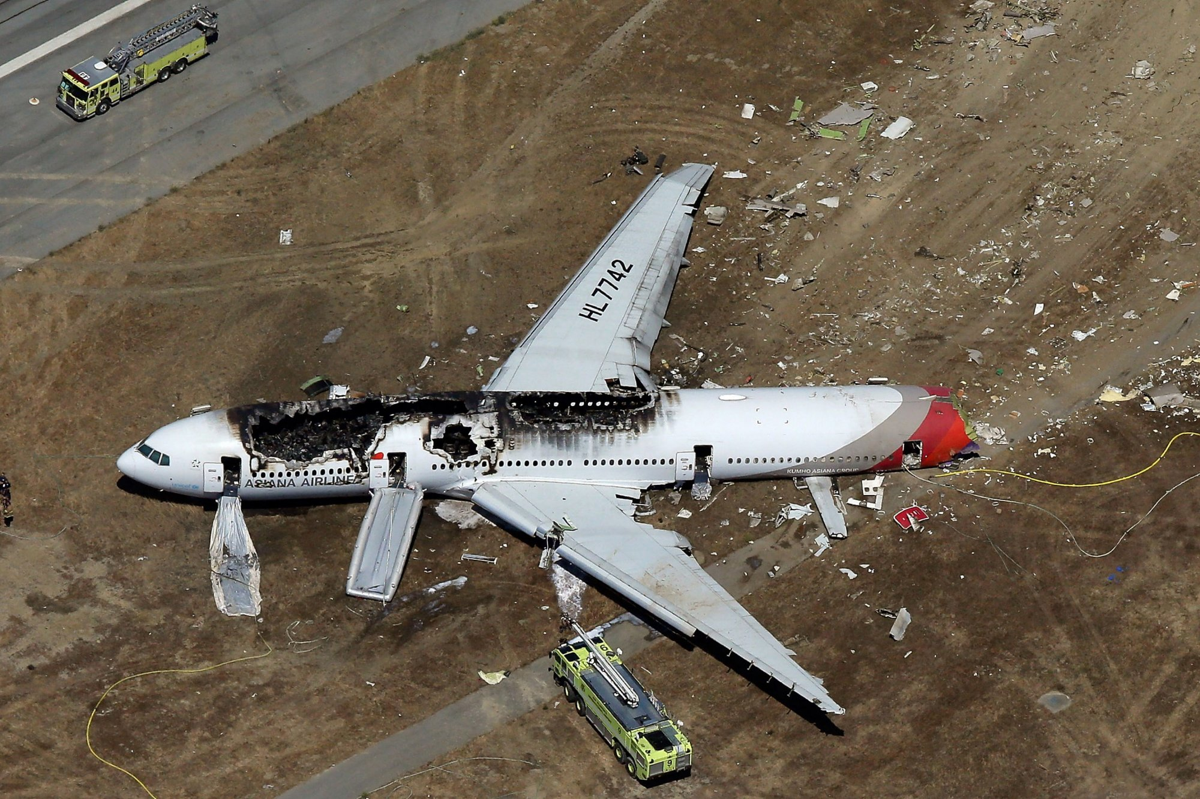
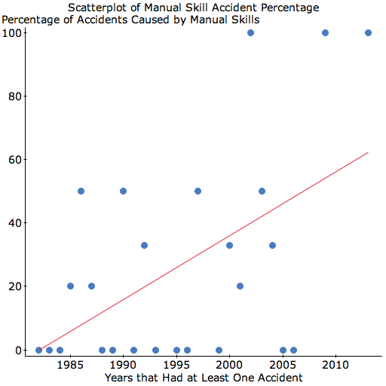
NEXTGEN and the Potential Negative Effects on Pilot Manual Flying Skills
James Willette and Dr. David Ison
Embry-Riddle Aeronautical University – Worldwide
ABSTRACT
RESULTS
DISCUSSION
NEXTGEN is a multi-level program intended to increase capacity in the National Airspace System (NAS) by transitioning from the World War II era technology of radar and ground based navigation aides to automated traffic de-confliction and satellite based navigation. Mandated by Congress to be complete by 2025, the system plans to revolutionize how aircraft transit from origin to destination however there are several aspects of NEXTGEN that potentially will have an effect on pilot manual flight skills. The FAA itself has warned that the NEXTGEN will require an even higher reliance on automation in all phases of flight which will result in reduced manual flying opportunities for pilots. While NEXTGEN promises more efficiency and greater capacity, one of the casualties of the new program would be the time allotted for manual flight skill practice. Numerous studies have highlighted pilot overreliance on automation and degradation of manual flying skills. Several recent accidents including Colgan Air 3407, Air France 447, and Asiana 214 indicate that inappropriate or inadequate pilot responses during manual manipulation of the flight controls is likely indicative of the aforementioned automation issue. This study examines the trend in the percentage of accidents related to overreliance on automation over time and how this relates to proposed use of technology in NEXTGEN. The findings of this study will help identify how increased reliance on automation is affecting the industry. Recommendations and suggestions for future research are also outlined.
Based of the limitations for the data, 66 accidents met the criteria to be analyzed. The accident rate per year ranged from 5 accidents, which occurred in five different years, and zero accidents, which occurred in seven years as shown in the chart below. It is obvious from the data that the number of accidents occurring every year has significantly declined in recent years. As the NTSB counts acts of terrorism as an accident, four of the accidents that occurred in 2001 were due to the terrorist acts on September 11th, 2001. With these accidents removed, it would be even more apparent that commercial aviation has become safer than it ever has been.
Because of the necessity for precision flight paths to adhere to the stricter separation guidelines, “Pilots may not use the [manual flight] skills as much on the line because of NEXTGEN requirements for more precise flight paths that can best be accomplished using the automated systems” (Lyall, England, Harron, Hoffa, Jones, Lyall, Taylor & Wilson, 2011, p.). While NEXTGEN promises more efficiency and greater capacity, one of the casualties of the new program would be the time allotted for manual flight skill practice. Performance based navigation transforms the flight planning and in-flight execution roles of pilots and air traffic controllers greatly from today’s system.
There is little doubt that the introduction of highly capable automated systems has been a boon for commercial aviation safety. The number of accidents continues to decrease to historic lows, to the point where the drive to the airport is more hazardous than a trans-continental flight. Automation saves money, increases efficiency, and improves passenger comfort. Simultaneously, automation has trickled down earlier into flight training programs, whereas pilots once learned the fundamentals completely with stick-and-rudder skills, now the autopilot can be relied on to assist workload even early in the training syllabus. Because of this abundance of automation in modern cockpits, pilots are much more apt to allow the system to fly the aircraft, rather than use the controls to fly themselves.
Recent accidents have shown an atrophy of basic manual flying skills that have caused major accidents with great loss of life. Without concrete and meaningful action, pilots will continue to be unprepared to take over their aircraft in hazardous situations, and this will lead to more preventable accidents.
METHODS
Both qualitative evaluative research and quantitative Pearson’s product-moment correlation methodologies were used to determine if automation proliferation throughout the airline industry had increased the number of accidents across the air transportation system.
Using evaluative research, airline recurrent training syllabi were analyzed to assess the emphasis placed on automation usage as well as explore the methods used to reinforce foundational manual flying skills. FAA Advisory Circulars and NTSB recommendations were investigated in cases where automation played key roles in accidents to see if and how findings are being assimilated into regulations or training syllabi. By evaluating the inputs provided by the findings of government regulators and the resulting outputs as used by the airline operators, this study was able to gauge the organizational effectiveness of the way lessons learned are translated to emerging problems such as automation overreliance.
Quantitative data used was obtained from the National Transportations Safety Board’s Aviation Accident Database in order to explore links between the amount and complexity of automated systems available to pilots in current aircraft, and the amount of accidents that have an automation error as a factor in an accident. The findings of this analysis indicated the number of accidents that had automation misusage as a probable cause as analyzed over the last 34 years.
The data showed a positive correlation between percentage of manual skill accidents over the study time period (r = 0.523, p = 0.007), which indicates that the null hypothesis should be rejected. There was a moderate correlation between the percentage of accidents with a probable cause of pilot manual skill error from 1982 until 2013. The data also shows that the correlation is a positive one, which indicates that accidents have been more likely to have pilot manual skill error as a probable cause since 1982.
INTRODUCTION
This research explored and analyzed the impact that sophisticated automation systems have had on the overall safety of airline operations, especially in the context of pilot foundational skill proficiency. Various sources of information such as accident reports, training syllabi, and currency requirements for both manned and unmanned aircraft will be examined to determine the key factors in accidents involving automation as a factor.
Although the use of automated aircraft systems has rapidly increased since the 1950’s, the complexities and reliance on these systems has also steadily increased. Today, flight operations occur with very little manual pilot manipulation of the controls. Several high profile accidents have occurred that potentially involved poor pilot handling due to reliance on automated systems. A critical part of NEXTGEN is based upon increased reliance on automation which is clearly problematic in light of the pilot skill degradation associated with such use.
REFERENCES
To request relevant references, please scan the below QR code:
CONTACT
Direct all correspondence about this research to Dr. David Ison, Research Chair, College of Aeronautics, Embry-Riddle Aeronautical University – Worldwide. Email: david.ison@erau.edu

