Slide 1
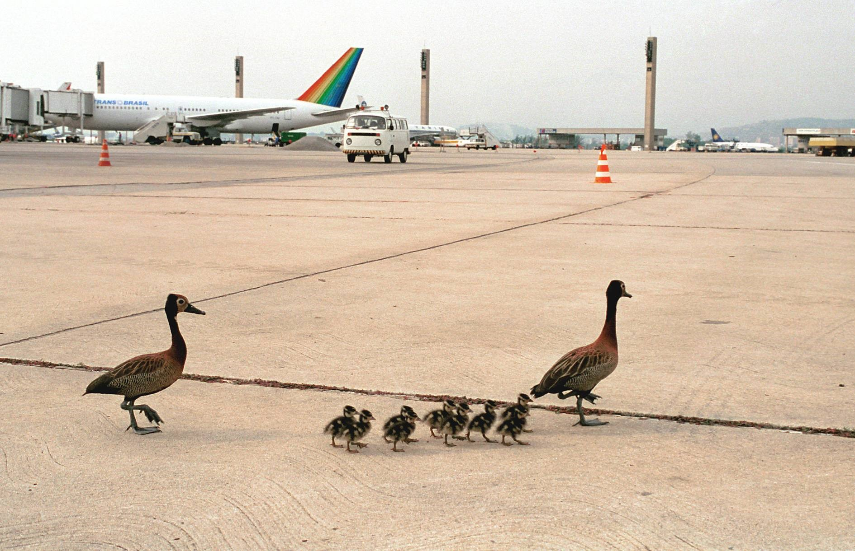
Integrating Sustainability and the Safety Management of Wildlife in Aviation
Flavio A. C. Mendonca and Dr. Mary E. Johnson
Purdue University
Abstract
Wildlife strikes are a serious aviation safety issue as demonstrated by the emergency forced landing of an Airbus 320 on the Hudson River in 2009. Reducing the risk of wildlife strikes on and near airports while assuring the sustainable development of the airport is a global challenge. Measures to reduce the risk of aircraft accidents due to wildlife may increase all types of impacts on the environment and society in absolute terms. Airport sustainability may be considered as somewhat abstract and primarily a global concept; however, the sustainable development of an airport leads to various benefits including increased profit and efficiency. Safety Management Systems (SMS) is an organization-wide comprehensive approach to managing aviation safety. Clearly, the ultimate goal of the SMS is enhanced safety. Utilizing the International Air Transport Association (IATA), International Civil Aviation Organization (ICAO), and the Federal Aviation Administration (FAA) views on sustainability and aviation safety, sustainability and wildlife management at airports concepts, and the ICAO SMS requirements, the Sustainability Management Systems Framework (SMSF) was developed to systematically and sustainably address wildlife hazard management on and near airports. The results show that an organized, systemic, and sustainable approach to managing wildlife on and near airports is plausible and will proactively yield safety enhancement while assuring the sustainable development of the airport.
Introduction
Wildlife and aviation can be a risky combination. Airport operators have spent significant financial and personnel resources in an effort to prevent or mitigate the possibility of aircraft accidents due to wildlife (Cleary & Dolbeer, 2005).
Actions needed to
reduce the risk of an
accident due to wildlife
may conflict with not
only regulations
protecting the
environment but
especially with the four
dimensions of
sustainability proposed by Janic (2004): operational, social, environment and economic. An SMS will provide airports with the capacity to anticipate and address safety issues before they lead to an accident. The purpose of this study was the development of a Sustainability Management Systems Framework to be used by airport operators. A systemic approach to aviation safety and may reduce losses, improve productivity, and is generally good for business. Yet, Willard (2012) states that addressing sustainability in a systematic way will, among many benefits, increase revenue and goodwill with stakeholders, reduce risks, and assure compliance with regulations.
Methods
In search of a general management method to allow airport operators to spawn a realistic and efficient balance between safety and sustainability while managing the risks of aircraft accidents due to wildlife, the authors developed a framework addressing the sustainable management of wildlife hazard on and near airports. This SMSF is based upon different views on aviation sustainability, aviation safety, the management of wildlife on and near airports, and the SMS concepts. For convenience, this framework considered the Janic’s (2004) four dimensions of sustainability. Airport operators may use this framework as a well-integrated scheme to help reduce the risk of aircraft accidents due to wildlife on and near airports while assuring the sustainable development of the airport.
Discussion
One of the key elements to maintaining the vitality of civil aviation is to ensure safe, secure, efficient and environmentally sustainable operations at the global, regional and national levels. Wildlife management has increasingly become a forefront issue for airports. Airports are required to provide a safe environment for all users, and wildlife around an airport can be detrimental to the safety of aircraft and passengers. The sustainable development of an airport implies its continuous growth, contributing to economic and social benefits, while simultaneously reducing its negative impacts on the society and the environment. Findings of this study suggest that addressing safety, sustainability and environmental issues related to the management of wildlife hazards in a systematic way will mitigate risks, cut costs, increase goodwill with stakeholders, and assure compliance with regulations, among many benefits. Moreover, it is realistic, achievable and profitable. The SMSF should be regarded as a formal, top-down business-like approach to sustainably managing wildlife on and near airports. It includes systematic procedures, practices, and policies for the management of safety and sustainability (including safety risk management, safety policy, safety assurance, and safety promotion) related to wildlife management. This SMSF is the adequate tool to translate an airport’s concerns about safety into effective actions to mitigate wildlife hazards without compromising the sustainable development of the airport.
References
Cleary, E. C., & Dolbeer, R. A. (2005). Wildlife hazard management at airports: A manual for airport personnel. Retrieved from http://wildlifecenter.pr.erau.edu/ Manuals/2005_ FAA_Manual_complete.pdf
DeFusco, R. P., & Unangst, E. T. (2013). Airport wildlife population management: A synthesis of airport practice (ACRP Synthesis No. 39). Retrieved from the Transportation Research Board on the National Academies website: http://www.trb.org/main/blurbs/169414.aspx
International Civil Aviation Organization (ICAO). (2013). Annex 19 to the Convention on International Civil Aviation, Safety Management (1st ed.). Montreal, Canada: Author.
Federal Aviation Administration (FAA). (2015a). Aviation emissions, impact & mitigation: A primer. Retrieved from http://www.faa.gov/regulations_policies/policy _guidance/envir_policy/media/primer_jan2015.pdf
Federal Aviation Administration (FAA). (2015b). Safety management systems for aviation service providers (Advisory Circular 120-92B). Retrieved from
http://www.faa.gov/regulations_policies/advisory_circulars/index.cfm/go/document.information/documentID/1026670
International Air Transport Association (IATA). (2015). Environmental policy. Retrieved from http://www.iata.org/policy/environment/Pages/default.aspx
International Civil Aviation Organization (ICAO). (2013). Annex 19 to the Convention on International Civil Aviation, Safety Management (1st ed.). Montreal, Canada: Author.
Janic, M. (2004). An application of the methodology for assessment of the sustainability of the air transport system. Journal of Air Transportation, 9(2), 40-82.
Junior, M. A., Shirazi, H., Cardoso, S., Brown, J., Speir, R., Seleznev, O., . . . McCall, E. (2009). Safety management systems for airports (ACRP Report No. 01, volume 2). Retrieved from the Transportation Research Board on the National Academies website: http://www.trb.org/main/blurbs/162491.aspx
MacKinnon, B. (2004). Sharing the skies manual – An aviation industry guide to the management of wildlife hazards. Retrieved from the Government of Canada Transport Canada website: http://www.tc.gc.ca/eng/civilaviation/publications/tp 13549-menu-2163.htm
Willard, B. (2012). The new sustainability advantage: Seven business case benefits of a triple bottom line. Gabriola Island, Canada: New Society Publishers
Results
The aviation industry lends itself pretty well to a framework that sustainably address the risk of aircraft accidents due to wildlife on and near airports. Almost everyone in this environment has a strong personal interest in safety. Moreover, there is a worldwide growing concern with sustainability initiatives in aviation, therefore it does not take much effort to get airport operators involved.
Pillars and elements of the proposed SMSF
This SMSF should be regarded as a formal, top-down business-like approach to sustainably managing wildlife on and near airports. It includes systematic procedures, practices, and policies for the management of safety and sustainability (including safety risk management, safety policy, safety assurance, and safety promotion) related to wildlife management. This SMSF is the adequate tool to translate an airport’s concerns about safety into effective actions to mitigate wildlife hazards without compromising the sustainable development of the airport. The management of wildlife is extremely complex and regulated by federal, state, and local governmental agencies. To date, no single industry publication has been written to provide a comprehensive and effective overview of this issue. Even though there is a vast literature and regulations recommending strategies to reduce the risk of wildlife strikes, none really addresses the impact of safety strategies on sustainability. In addition, there is a need to measure the benefits and impacts of these strategies in order to make adequate decisions. This concepts echo MacKinnon (2004) previous findings. Expanding populations of wildlife at and around airports and increased air traffic by quieter, turbofan-powered aircraft are two of many reasons for the growing conflict between aviation and wildlife all over the world (Cleary & Dolbeer, 2005). The implementation of the Sustainability Management Systems Framework will reduce the risk of aircraft accidents due to wildlife, give the airport operator a structured set of tools to meet legal responsibilities, incorporate internal evaluation and quality assurance concepts that can result in more structured management and continuous improvements of operational processes. The expected outcomes are significant improvements in aviation safety and sustainability regarding wildlife management by airport operators.
Policy and objectives | Management commitment and responsibility
 | Sustainability accountabilities
 | Appointment of key personnel
 | Coordination of emergency response planning
 | Documentation
Risk management | Hazard identification
 | Sustainability assessment and mitigation
Sustainability assurance | Performance monitoring and measurement
 | Continuous improvement of the system
Promotion of sustainability | Training and education
 | Communication

