Slide 1
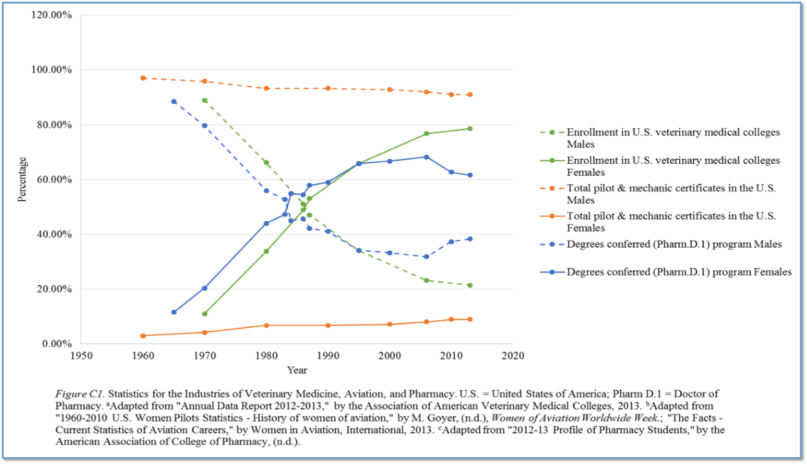
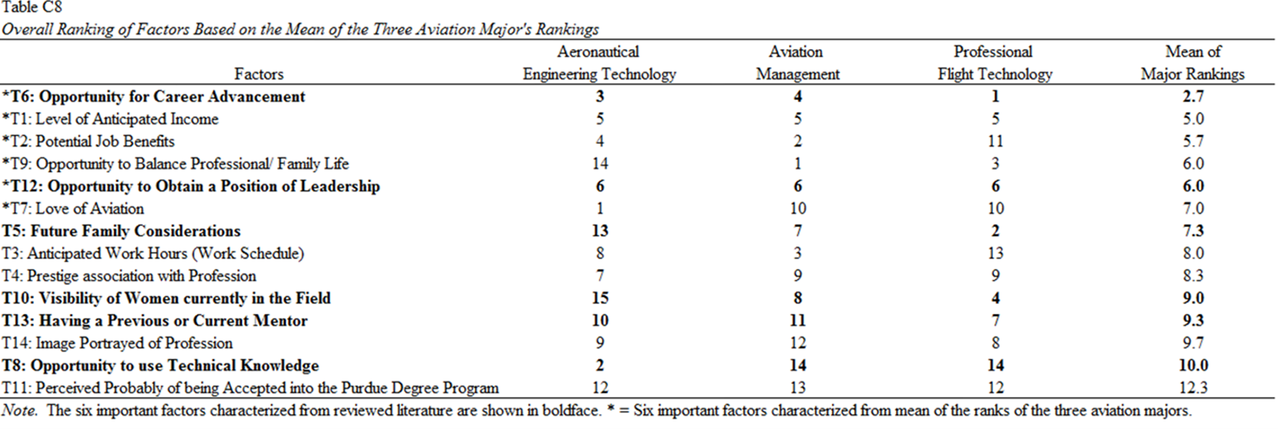
Mary E. Johnson, PhD
Assistant Department Head Research/Associate Professor
Department of Aviation Technology
Purdue University
Attracting Women to Aviation
Dekiyra L. Love, M.S.
Department of Aviation Technology Purdue University
Suggestions from Industries Experiencing Gender Shift
ABSTRACT
Aviation is one of the most adventurous and stimulating fields of study in academia. However, the current industry is struggling to fulfil current future demand for pilots and mechanics. Projections from major corporations, such as Boeing and Airbus, have indicated that a large number of personnel will be needed throughout the next 20 years to not only maintain the existing system, but match its projected growth. With forecasted industry shortages, the fact that women comprise 50.8% of the U.S. population, and statistics indicating 56.4% of women attend college as compared to 43.6% of men, it would be in the industry's best interest to consider suggestions of how to attract more women to aviation. With that said, many once male-dominated industries are now experiencing a growth in the participation of women, and in some cases, a gender shift. This paper evaluates the female-dominated industries of Pharmacy and Veterinary Medicine, as well as, current insights from female students in collegiate aviation at Purdue University in the Department of Aviation Technology. Factors that are important to women in aviation are developed, and techniques that could potentially increase the participation of women are suggested.
This study concludes that these factors are potentially the most important
regarding attracting women to aviation …
Opportunity for Career Advancement, Level of Anticipated Income, Potential Job Benefits, Opportunity to Balance Professional/ Family Life, Opportunity to Obtain a Position of Leadership, and Love of Aviation
Aviation is struggling to attract future female pilots & mechanics
Aviation
1960 - 1980: Female pilots and mechanics increased from 2.94% to 6.74%
2013: Female pilots and mechanics 6.61% (pilot), and 2.34% (mechanic)
Pharmacy
1965: Pharmacy degrees conferred by women was 11.47%
2013: Pharmacy degrees conferred by women was 61.66%
Veterinary Medicine
1970: Enrollment in U.S. veterinary medical colleges was 11.00% women
2013: Enrollment in U.S. veterinary medical colleges was 78.60% women
INTRODUCTION
Aviation is on the threshold of a shortage of skilled pilots and mechanics
Boeing Projects:
World’s average fleet will grow at a rate of 3.6%, creating a need for 36,700 new airplanes valued at $5.2 trillion
By 2020 Aviation will….
Force retire 2,650 pilots
By 2034 Aviation will….
Need 533,000 new commercial airline pilots
Need 584,000 new maintenance technicians
Need 27,000 new pilots and 29,000 new technicians annually
Aviation must...
1. Consider the 50.8% of the population that is not currently proportionally represented in several aviation careers
2. Identify proven factors that can be utilized to attract future skilled female specialists to all fields
The goals of this study were to:
(a) Identify factors or activities that have led to a gender shift from men to women for the once male-dominated industries of Pharmacy and Veterinarian Medicine
(b) Identify factors that have attracted collegiate women to their respective majors within the Aviation Department at Purdue University,
(c) Identify factors or activities that the aviation industry may learn from the industries of Pharmacy and Veterinarian Medicine to aid in attracting women to the field of aviation and aviation collegiate programs
Why the medical Industry?
Aviation, Pharmacy, and Veterinary Medicine are all complex industries where individual lives are at stake, safety is of the upmost priority, and there is a high reliance on skillfully trained professionals to achieve quality results.
The medical industry has already learned from the aviation industry...
Checklist usage , Simulator training,
Operation-based briefings, Structured communication
Now it is time that aviation embraces a few suggestions from the medical industry in terms of attracting women to the field of aviation
Purpose of this study was to investigate approaches to attract women to aviation as a possible means of mitigating forecasted industry shortages
METHODOLOGY
Study conducted a survey sampling the current population of 91 female undergraduates – 19.48% of the students – currently enrolled at Purdue University in the Department of Aviation Technology under the degree classifications of Aeronautical Engineering Technology, Aviation Management, and Professional Flight Technology. The goal was to identify factors that have attracted collegiate women to their respective majors. The survey had two free response questions, and 14 questions to be answered using a seven-point scale Likert Scale that utilized an unimportant - important scale. Due to the limited number of female students, the survey was administered to both male and female students, and used skip-logic and demographic questions of gender and age to narrow the results to the target population.
Findings in previous research identified 14 factors as important for women and their respective industry. Of the 14, six were identified as important to all three industries, and are shown in boldface in the Table. Overall, 24 out of a possible 91 responses were recorded - 34 females (37%) and 59 males (63%)
Cronbach’s Alpha determined a high level of reliability (α = 0.902). Pearson’s Chi-squared Test for Independence tested the H₀ that the 14 factors are independent of the three aviation majors, based on a probability of a Type 1 error (α = 0.050); X²(91, N=24) = 107.362, p<0.116, and found the variables not statistically significant.
RESULTS
A sample larger than 24 responses may increase the likelihood of the Bonferroni test to detect differences in the majors. Overall, there were no findings of statistical significance between the dependent and independent variables. A crosstabulation was performed that totaled data from each major for each factor of the Likert Scale. Responses from only the somewhat important, very important and extremely important categories. The factors were ranked by importance based on the total calculated responses. Each major’s individual rank of the 14 factors were used to determine a mean for each factor. The factors were then ranked based on the mean score to obtain an overall rank of the factors based on the level of importance designated from each major. The table displays the results, with considerations from reviewed literature and crosstabulation analysis, of which factors are potentially the most important regarding attracting women to aviation.
Top 3 Ranks for Each Major:
Aeronautical Engineering Technology
T7: Love of Aviation
T8: Opportunity to use Technical Knowledge
T6: Opportunity for Career Advancement
Aviation Management
T9: Opportunity to Balance Professional/ Family Life
T2: Potential Job Benefits
T3: Anticipated Work Hours (Work Schedule)
Professional Flight Technology
T6: Opportunity for Career Advancement
T5: Future Family Considerations
T9: Opportunity to Balance Professional/ Family Life
One-way Analysis of Variance (ANOVA) Test conducted on each of the 14 factors determined T8: Opportunity to use Technical Knowledge and T9: Opportunity to Balance Professional/ Family Life as statistically significant.
T8: (F(2, 21) = 4.032, p = .003)
T9: (F(2, 21) = 3.779, p = .040)
Bonferroni Post Hoc Test for Multiple Comparisons was performed on T8 & T9, to determine which means (aviation majors) were different. The difference in means of the responses for each possible combination of majors were determined to not be significant at α = 0.05.
DISCUSSION
Research has proven that despite being in a male-dominated technical major, women still feel that balancing family and professional life is of the upmost importance. Recommendations from industries include aiding in diminishing stereotypical barriers against women, encouraging industry representatives to hire more women, developing methods to prevent career restrictions, making sure companies acknowledge the accomplishments of women and support their advancement into upper level positions, encouraging involvement in professional organizations and classes centered on developing management techniques, increasing awareness of potential benefits, attempt to capture the attention of females at a younger age, encouraging women to developed leadership skills and self-assurance early in life with participation in aviation-based student organizations, and provide opportunities for a return to service agreement, which has nothing to do with maternity-leave, and would allow women to leave the industry for a period of time, and return to work with the same pay, status, and benefits they were receiving when they initially left. Overall, this research concludes that the recommendations from Pharmacy and Veterinary Medicine have the potential to attract women to aviation.

