Slide 1
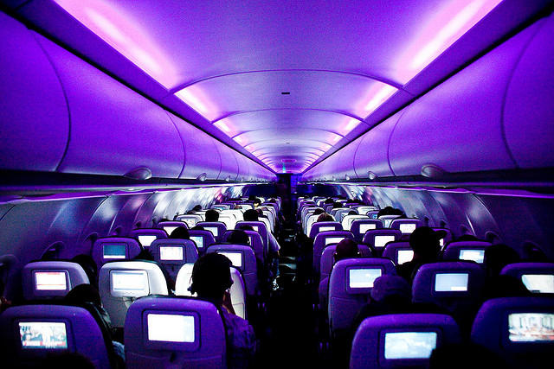
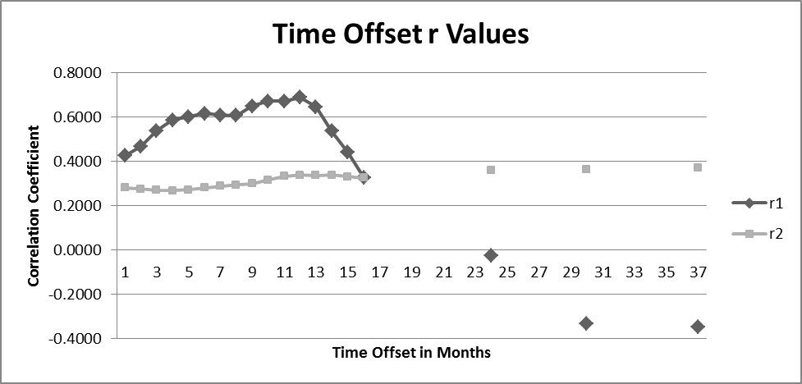
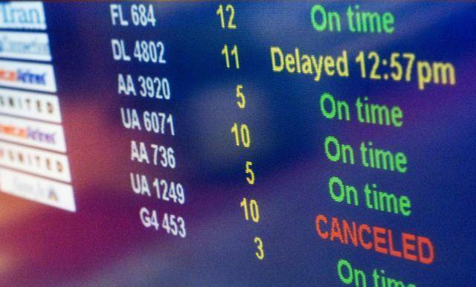
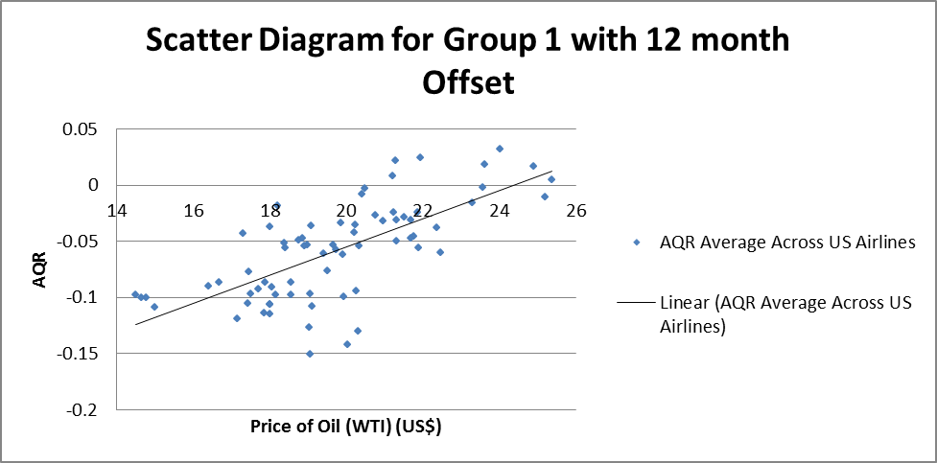
Correlation of Oil Prices and Airline Quality
Nicholas Kirsch and Dr. David Ison
Embry-Riddle Aeronautical University – Worldwide
ABSTRACT
METHODS
RESULTS
Numerous studies have been conducted on the ripple effects caused by a change in the price of oil on the aviation industry. Exigent research indicated that crude prices can significantly impact airline revenues however, what remains relatively uninvestigated is the effects this has on airline operations. Literature has suggested that rises in oil prices and subsequent negative fiscal effects on the airline operations may lead to lapses in safety and customer service yet much of this has been based on speculation. Clearly, such influences can have lingering consequences for airlines, potentially dragging out negative financial performance well into periods of economic recovery and reduced oil prices. The purpose of this research was to empirically examine the effect the price of oil has on commercial airline passenger travel, specifically airline customer service metrics, as indicated by the Airline Quality of Rating (AQR). A correlation analysis was used to identify the relationship of average annual oil prices and average AQR values from 1991 to 2013. The findings of this study allow airline stakeholders to better understand the impacts of economic factors on operations and to potentially mitigate the negative effects thereof through proactive measures. Also, these results assist in identifying factors that may influence the AQR.
This quantitative, correlational study investigated the influence oil prices may have on airline quality as measured by the AQR. Numerous studies have been conducted on the ripple effects caused by a change in the price of oil which was be utilized to support the analysis in this project. One of the primary resources used in determining AQS level will be the annual Airline Quality Rating (AQR) Report, published annually by Embry-Riddle Aeronautical University, ERAU Scholarly Commons, as far back as 1991. Existing data (i.e., AQR reports), as well as scholarly publications on the price of oil over time, customer satisfaction, historical investments in technology, and industry practices were analyzed and considered as part of this project’s conclusion. Statistical analysis was used to determine a relationship between the price of oil and AQR.
The statistical portion of this study was guided by the following hypotheses:
H1: There is a correlation between the price of oil and AQR of the airline industry as a whole.
H0: Changes in the level of AQR in the airline industry are not correlated to changes in the price of oil.
As guided by the literature, it was realized that oil price changes may not have an immediate impact on airline quality. As such, it was decided to run the calculation for the correlation coefficient multiple times, each time increasing the offset between the price of oil and the AQR by one month. For example the price of oil in January 1990 (x1) was calculated against the AQR for February 1990 (y2), and so on (x1) against (y3), (x1) against (y4), etc. for sixteen months. Then it was repeated three more times with a 24 month offset, a 30 month offset an finally a 36 month offset.
For the first set of data (January 1990 to December 1997) the correlation coefficient calculated using the product moment correlation coefficient was weak to moderate (r1 = 0.3655; p < 0.01). For the second set of data (January 1998 to December 2013) the correlation coefficient calculated using the product moment correlation coefficient was r2 = 0.2789 (p < 0.01), indicating a weak correlation.
After analyzing the first set of data, an upward trend in correlation values was identified peaking at the twelve month offset point (r = 0.6893; p < 0.001) which indicates a potential moderate to strong positive correlation between the price of oil and the AQR at twelve months for the first set of data. Analysis of the second set of data shows a slightly positive trend; however, further offset resulted in correlation values that stabilized or reduced.
With the identification of a potential positive correlation when imposing a twelve month offset (delay) between the price of oil and the AQR for the first set of data the next step was to do a regression analysis on the same set of data using the method of least squares to obtain the regression line.
The result from calculation was b = 0.012591 and a = -0.30726, therefore the function for the regression line was:
y = -0.30726 + 0.012591x
DISCUSSION
Evidence from the initial analysis provided support for the alternative hypothesis indicating a correlation between oil price and AQR, albeit weak. Perhaps more compelling was the positive correlation between the price of oil and the average US airline AQR rating twelve months later (using the original nineteen factors) indicates an interesting, perhaps counterintuitive, potential relationship in which the increase in the price of oil results in an increase in customer satisfaction twelve months later. This may indicate economic cycles in which air carriers adjust or compensate for costs in certain areas following fuel price spikes. It also may reflect the elasticity of ticket prices and consumer responses to such over time. Clearly, more research is necessary to better explore these prospective associations.
REFERENCES
INTRODUCTION
To request relevant references, please scan the below QR code:
The objective of this research was to investigate connections between the price of oil, its effects on airline profitability, and any correlations or regressions between airline profitability and Airline Quality of Service (AQS); ultimately, connecting the price of oil and AQS. This study identified the extent to which the price of oil is, or is not, a significant factor affecting the AQS, and recommend how to improve AQS in an environment where oil price fluctuations are the norm. This project confines the scope of its study to commercial airline passenger travel and its associated supporting industries from 1990 to 2015. This period of time was chosen because it is relatively recent and contains a large amount of fluctuations in the price of oil, which helps in identifying a corollary relationship.
CONTACT
Direct all correspondence about this research to Dr. David Ison, Research Chair, College of Aeronautics, Embry-Riddle Aeronautical University – Worldwide. Email: david.ison@erau.edu

