Slide 1

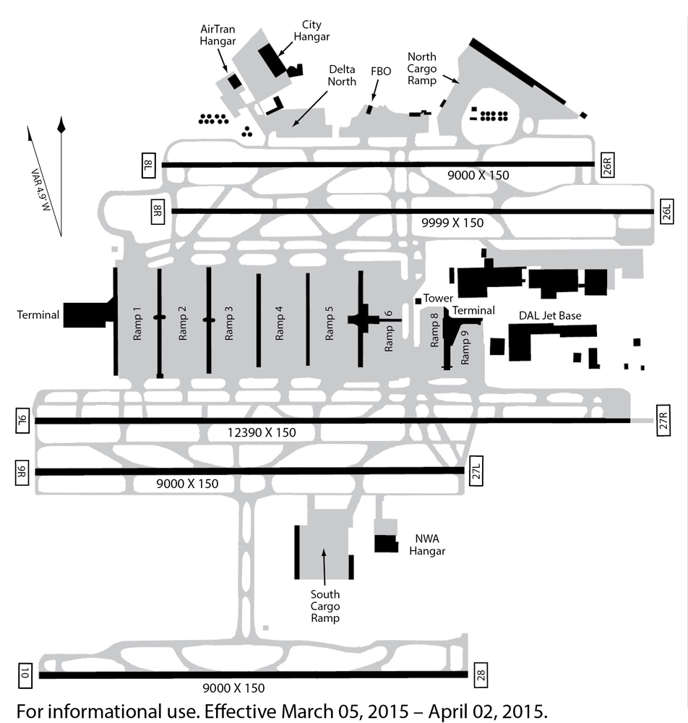
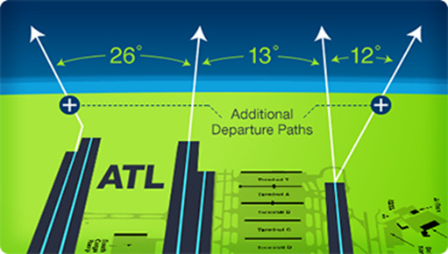
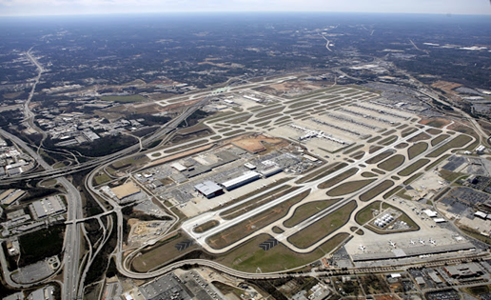

Impacts of NEXTGEN Procedures on Delays at Atlanta Hartsfield-Jackson International Airport
Jon Hadler and Dr. David Ison
Embry-Riddle Aeronautical University – Worldwide
ABSTRACT
DISCUSSION
Air traffic control delays are not only frustrating to the public but also have tremendous impact on the quantity of fuel consumed which in turn lead to a negative impact on local air pollution. Inefficient routing management by air traffic control has been shown to exacerbate delays as well as generate unnecessary, wider-spread noise pollution. The purpose of this study was to determine the extent that air carrier departure delays at a large hub airport, Atlanta Hartsfield-Jackson International (ATL), were affected by precision navigation departure procedures that were implemented as part of the Federal Aviation Administration’s Next Generation air traffic control program (NEXTGEN). This study examined the significant causes of the delays and how the causes relate to one another. It also examined the effects of delays and examined technology used to reduce delays. This study included data from the FAA, ATL, and the U.S. Department of Transportation (U.S. DOT) Bureau of Transportation Statistics (BTS). A statistical analysis of data from these sources was used to determine what effects the implementation of NEXTGEN precision departure procedures had on delays. Suggestions for future research are also outlined.
The problem of flight delays needs many solutions to be reduced significantly. Many methods of managing delays need to be put to use on a daily basis by airline, FAA, and airport employees. NEXTGEN capabilities such as RNAV departure procedures have improved operations at ATL, but do not seem to show much of an impact on reducing the number or length of delayed flights, which is a troublesome problem. Many variables affect the length and number of delays, which makes it difficult to isolate a specific improvement to determine the impact it had on delays. The 9/11 terrorist attacks, variable economic conditions, and other factors dynamically affected daily airline operations at ATL during the past 15 years. Delays continue to be a serious problem at ATL and need to be addressed to improve safety, productivity, and efficiency. Other options to reduce delays could include larger capacity aircraft to reduce the number of operations, airport capacity restrictions, 24-hour-a-day operations, additional NEXTGEN capabilities, etc.
Further study of the data related to RNAV and NEXTGEN improvements might discover more conclusively the exact difference RNAV and other NEXTGEN capabilities are making in reducing delays at ATL and throughout the NAS.
RESULTS
Multiple MWU tests were completed to compare data from before and after implementation of RNAV departure procedures and RNAV ELSO procedures. Most of the comparisons did show a statistically significant difference, but some showed a decrease in the length of delays and some showed an increase in the length of delays. One comparison showed no statistically significant difference.
The MWU tests for the year groups of 2000 to 2005 and 2007 to 2012 indicated that a statistically significant difference existed between delayed gate departures and between taxi-out times. In both cases, an increase in the length of time of gate delays and taxi out time was shown after RNAV departure procedures were implemented. This was likely influenced by the total number of departures and other factors, such as 9/11. With these results it is difficult to claim that RNAV departure procedures have had much of a positive effect on delays, whether with gate departures or during taxi out, based on the analysis conducted. Additional research might be able to uncover more affirmative results.
Gate vs. Airport Departure On-Time Rates
INTRODUCTION
ATL had a very low 58% on-time airport departure rate in 2004, based on 477,323 departures, but for 2014, 73.5% of 428,945 airport departures were on-time (FAA, 2015a). Delays remain a serious problem for ATL and other major U.S. airports. ATL is an airport that is considered congested by the FAA and delays at ATL are forecasted to rise through 2020 (FAA, 2015, January).
Many NEXTGEN capabilities have already been implemented at ATL, such as airport surface detection equipment (ASDE-X), performance based navigation (PBN) procedures, reduced divergence standard instrument departure (SID) area navigation (RNAV) procedures, equivalent lateral spacing operations (ELSO), etc.
Overview of Atlanta Hartsfield-Jackson International
METHODS
ATL RNAV Standard Instrument Departures
Both qualitative literature reviews and quantitative Mann-Whitney U (MWU) methodologies were used to determine if NEXTGEN RNAV procedures had an effect on the length of delays at ATL.
With the addition of RNAV ELSO procedures at ATL in October 2011, the FAA performed an operational test to determine the benefits of adding ELSO. Revised RNAV SID procedures added a fourth departure route and allowed divergent departures from two additional runways. A 1.5 minute reduction in delay was noted for each aircraft after RNAV ELSO departure procedures (Mayer, et al., 2013).
Quantitative data was obtained from the FAA OPSNET database to examine the effect of revised RNAV departure procedures on the length of delayed gate departures and the average minutes of taxi out time for flights departing ATL. Statistical analysis of ex post facto data from different year groups was completed using MWU tests because the data was not normally distributed.
Delayed Gate Departures
REFERENCES
To request relevant references, please contact the Embry-Riddle Worldwide student author, Jon Hadler.
Email: jmhad88@gmail.com
CONTACT
Direct all correspondence about this research to Dr. David Ison, Research Chair, College of Aeronautics, Embry-Riddle Aeronautical University – Worldwide. Email: david.ison@erau.edu

