Slide 1
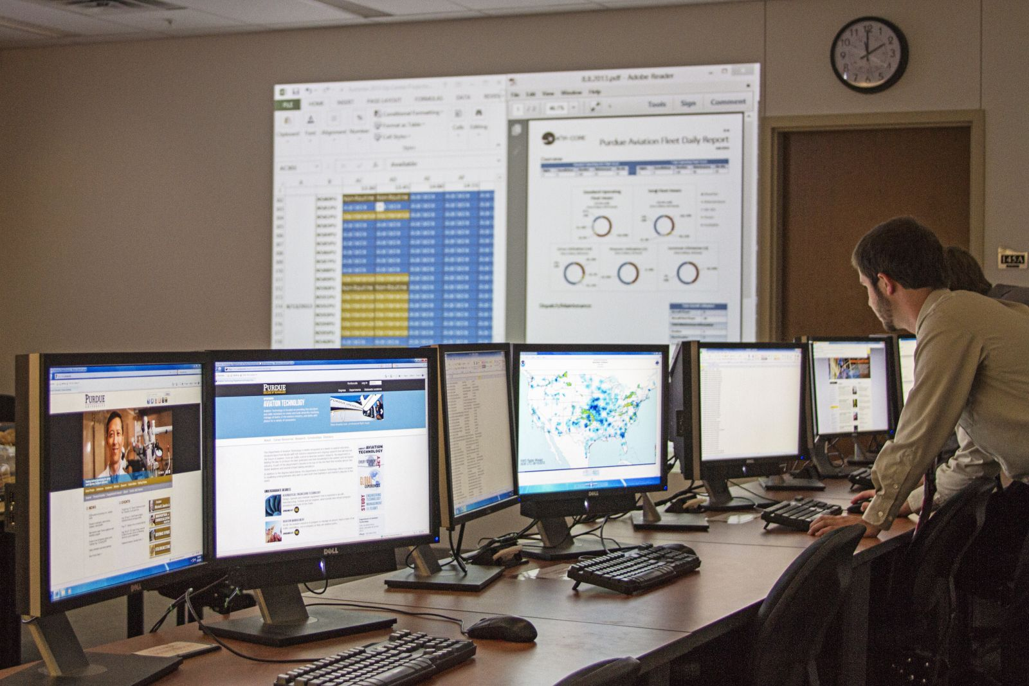
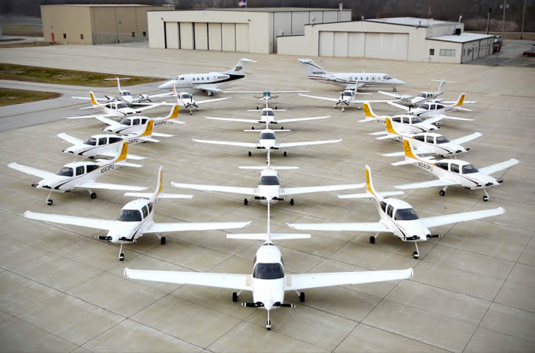
John Mott Faculty Advisor
Mark Ball Graduate Researcher
Current Research
Applied External Research
United Airlines
United Airlines has partnered with Purdue to work on projects regarding Resource Optimization and Planning. Some of the work included developing dynamic staffing models for overtime, cargo running, and baggage service office operations. Both undergraduate and graduate students have visited United’s hubs to gather observations and data needed and deliver presentations.
Delta Airlines
Delta Air Lines has launched a Human Factors Sustainability Initiative and partnered with Purdue University for access to research and data analysis. The project involves investigating impacts of safety from a human factors perspective in Delta's Line Maintenance division. Data is gathered from existing databases and reports. Graduate and undergraduate students also visit Delta's hub stations to carry out observations and surveys of line maintenance employees.
Abstract
The Advanced Aviation Analytics Institute for Research (A³IR- CORE), a University-level Center of Research Excellence that resides in the Department of Aviation Technology, is focused on the dual mission of solving industry problems and providing educational experiences for students by actively involving both graduate and undergraduate student researchers working closely with faculty mentors in a highly-collaborative multidisciplinary environment. The Center is sponsored by industry partners, and a portion of the research performed is done so in conjunction with those partners. The research agenda of the Center is concentrated primarily in the area of operational assessment and improvement of the aviation enterprise. This work is accomplished through three divisions: an internal division which works with the Aviation Technology Department’s flight and maintenance operations, an external division working with industry sponsors, and a scholarship division which disseminates the research of the first two divisions through internationally-recognized conferences and peer-reviewed scholarly journals.
The Advanced Aviation Analytics Institute for Research a Center Of Research Excellence
Current Research
Applied Internal Research
Operations Center
The Purdue Aviation Technology Operation Center is focused on tracking and monitoring multiple aspects of the operation of Purdue University’s aircraft fleet. Responsibilities include managing the Research Center’s computer system, automating data inputs, troubleshooting various information systems, among other tasks. This is a unique opportunity for students to jumpstart professional development, networking and resume building. The focus areas are
Fleet Utilization
Maintenance
Weather
Air Traffic Control
Dispatch
Ramp Control
Purdue Aviation Operations Center
Introduction
Within Purdue’s Department of Aviation Technology there is a need for undergraduate participation in department research and practical use of new knowledge outside of the classroom. Using what students learn in class, undergraduates work in teams led by graduate students and solve industry issues and learn research methods concurrently.
Flagship Functions
Cultivate undergraduate research by facilitating teams composed of faculty mentors working alongside graduate and undergraduate students
Offer graduate students opportunities to lead research teams
Explore new and emerging research methodologies and apply those methods to existing and innovative research ideas
Contribute to Purdue e-Pubs, a subsidiary of Purdue University Libraries
Open access publishing
Contribute to Journal of Aviation Technology and Engineering (JATE)
Double-blind, peer- reviewed journal published biannually
Promotes the bridging of aviation technology and engineering
Organizational Structure
Purdue’s Fleet
A³IR-CORE
Applied Internal Research
Applied External Research
Scholarship
Aviation Technology Operations Center
Airline Partnerships
Other Research Projects
JATE
E-Pubs

