Slide 1
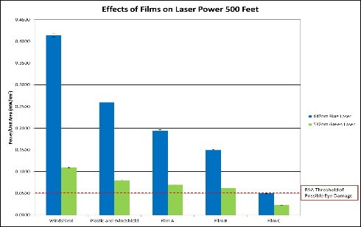
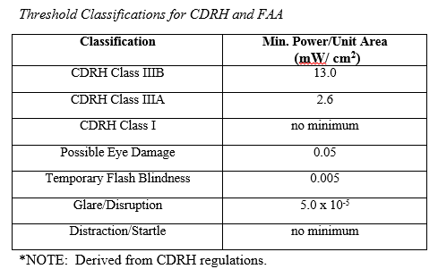
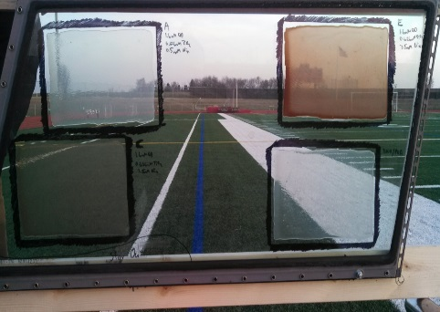
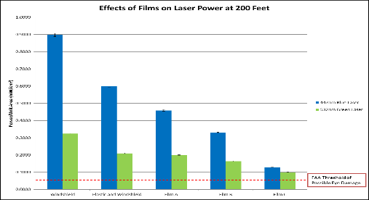
Flight Deck Laser Illumination Events: A Study to Mitigate Crew Exposure
Lewis University
Joseph Burlas, Steven Emmert, Jacob Luedtke, Matthew Moy
Abstract
Between the years 2006 and 2012, the Federal Aviation Administration’s (FAA) Laser Safety Initiative indicated a thirteen-fold increase in laser incidents. Previous studies indicate damage potential to crewmember’s eyes from laser attacks according to standards established by the federal government. Photoresistant coatings were applied to aircraft windshields to investigate the attenuating effects on laser light intensity. Four coatings were applied in liquid form directly onto the windshield. After partial drying, each coating was heat treated to cure onto the surface and allowed to dry completely. Using an optical power meter, laser intensity data were obtained through the coating and untreated windshields. Data revealed a reduction in laser intensity through all applied coatings. Results lend support of the view that coatings applied to aircraft windshields may improve flight safety, and the potential risk of eye damage to flight crewmembers may be reduced with the application of photoselective coatings.
Introduction
Representatives of the aviation community are interested in mitigating the effects of flight deck laser illuminations. In 2012, the Federal Aviation Administration (FAA) reported 3,482 laser attacks in the United States alone with only 300 attacks being reported in 2006. Advancements in laser illumination protection may provide solutions to reduce the intensities of laser light illuminations. Early attempts at reducing laser intensity have included various forms of protective eyewear or visors. It was determined these alternatives were not ideal for a variety of reasons. This study sought a mitigation method where normal flight activities would not be obstructed, yet the effects of the laser could be lessened if not eliminated completely.
Methods
Discussion
The purpose of this study was to test the application of various photoselective coatings to aircraft windshields in order to mitigate laser exposure to crewmembers. Findings suggest a reduction in laser intensity through all coatings, with both lasers, at all ranges. Coating C successfully lowered the threshold classification from possible eye damage to temporary flash blindness. Even though the laser intensities through coatings A and B were not below the FAA definition of possible eye damage there was a meaningful reduction in laser intensity when shone through the coatings tested in this study. Even though the laser intensities through coatings A and B were not below the FAA definition of possible eye damage there was a meaningful reduction in laser intensity when shone through the coatings tested in this study. In terms of specific reductions in laser intensity through coating application, the results of this study are unique in that the researchers provide an initial data point to support the application of photoselective coatings.
References
.,
Used Boeing 737NG Windshields (Donated by Southwest Airlines).
Three readily available lasers were selected, a green, a red, and a violet.
Lasers utilized for this study were classified as FDA IIIb devices (refer to table below).
Table 2.
Results
In a previous study by Demik et al (2013), as distance increased the diameter of the beam increased while the laser intensity decreased. This was consistent with findings from this study. As the nanoparticle concentrations increased, the intensity of both lasers decreased at the aforementioned ranges (refer to Table 1 & 2). Examination of the data reveals possible eye damage at all ranges through the windshield, PVA, and coatings A and B. Coating C reduced the laser intensity to the CDRH classification of temporary flash blindness at 200 and 500 feet with both colored lasers. It is noteworthy to mention that there was meaningful reduction in laser intensity through all coatings ranging from 36-88% (refer to Table 1 & 2).
The coatings are proprietary modified fluorescent scintillator materials deposited into a thin transparent plastic. Scintillator materials were treated with an organic “cap” to chemically modify the response mechanism. Resultant materials were introduced into a liquid polymer and allowed to disperse. Coatings are applied in liquid form directly onto the windshield. After partial drying, the coating was heat treated to cure onto the surface and allowed to dry completely (Figure 1).. Researchers used a Newport 918D-SL-OD2R detector with a Newport 1918-R power meter to measure laser intensity with a reported calibration uncertainty of ±1% in the range of 400-940 nanometers.
Anderberg, B., Bring, O. E., & Wolbarsht, M. L. (1992). Blinding laser weapons and international humanitarian law. Journal of Peace Research, 29(3), 287-297.
Blasse, G. (1994). Scintillator materials. Chemistry of Materials, 6 (9), 1465-1475.
DeMik, R. J., Harriman, S. L., Phillips, R. S., Crowder, C., Pfeifer, J. A., McHugh, S. F., Foster, S. J., Waard, E. R., Streit, M., Antoniolli, R. B., Knight, E. W., York, D. S., & Luedtke, J. (2013). Measuring intensity of laser light penetrating flight decks in laser illuminations. Journal of Aviation Technology and Engineering, 3(1), 1-8.
Federal Aviation Administration. (2012). Laser safety initiative. Retrieved from http://www.faa.gov/about/initiatives/lasers/
FAA Modernization and Reform Act of 2012, H. R. 658, 112th Cong. (2012). Retrieved from http://thomas.loc.gov/cgi-bin/bdquery/D?d112:1:./temp/~bdrYOx::|/home/LegislativeData.php?n=BSS;c=112|
Federal Bureau of Investigation. (2013). Number of reported laser incidents targeting inbound commercial aircraft to New York City airports increases. Retrieved from http://www.fbi.gov/newyork/press-releases/2013/number-of-reported-laser-incidents-targeting-inbound-commercial-aircraft-to-new-york-city-airports-increases
Food and Drug Administration. (2014). Laser products and instruments. Retrieved from http://www.fda.gov/radiation-emittingproducts/radiationemittingproductsandprocedures/homebusinessandentertainment/laserproductsandinstruments/default.htm
Nakagawara, V. B., Montgomery, R. W., & Wood, K. J. (2011). Laser illumination of flight crew personnel by month, day of week, and time of day for a 5-year study period: 2004-2008 (Publication No. DOT/FAA/AM-11/7). Washington, DC: U.S. Government Printing Office.
PPG Aerospace Transparencies. (2012). Transparency Bulletin: Boeing Next-Generation 737, Classic 737, 727, 707 Windows. Retrieved from http://www.ppg.com/coatings/aerospace/transparencies1/Boeing_737_SPARES_2012_final.pdf
Svec, L. (2005). The effect of spectrally selective filters on color perception and aviation performance. Doctoral dissertation. Retrieved from ProQuest Digital Dissertations.
Table 1
Figure 1

