Slide 1
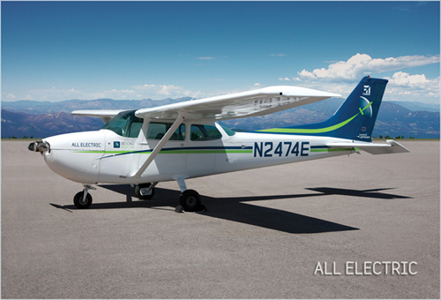
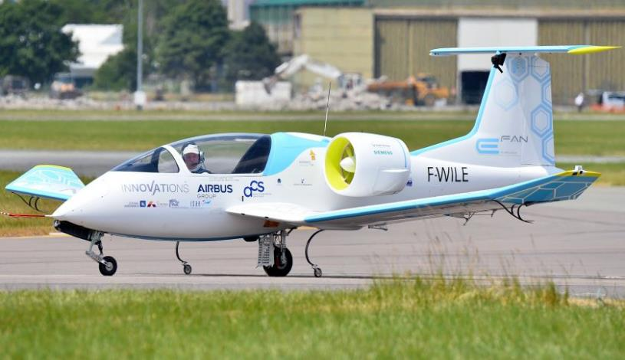
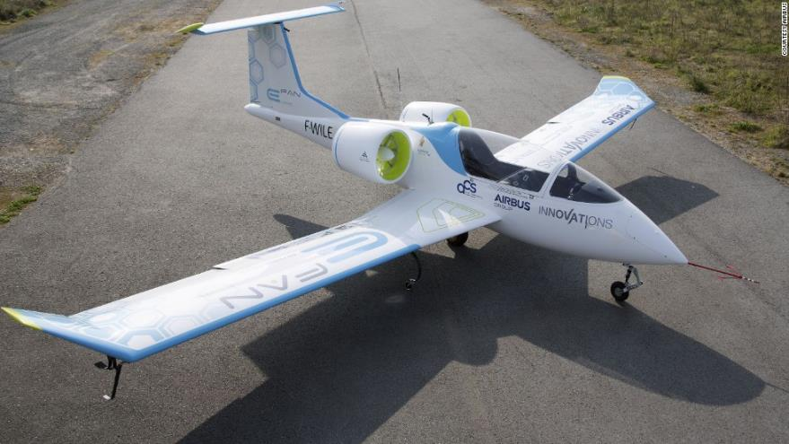
Renewable Energy Sources
in the FAR Part 141 Curriculum Aviation Training Environment
Andrew Thomas
Advisor: Steven Goetz
Methods
Comparison of aircraft powerplant systems components (Gasoline or Electric)
Academic journal searches regarding alternative energy systems and their manufacturers
Investigation of Cessna, Piper, Diamond, and Cirrus research and development focus areas
Considerations of FAR Part 141-accredited university flight program budgets and priorities regarding fleet leasing or purchasing
Accessibility of replacement parts for training aircraft and the maximum allowable down time due to maintenance
Review of reliability charts, tables, and articles
Abstract
The purpose of this presentation is to address the merging of two major topics in modern society: renewable energy and the aviation industry, specifically in the training environment. This undergraduate research presentation portrays the feasibility, availability, and opportunity associated with alternative energy-powered aircraft in the training environment. The focus is on the long-term investment of a renewable-energy aircraft fleet in the FAR Part 141 training environment amongst several aviation universities in the United States, and the finances related with the purchasing and maintenance of such training aircraft fleets. The investigation included an evaluation of the financial constraints that aviation universities face, the requirements of the fleet as a whole, and the future of said transactions through maintenance considerations, both financially and resourcefully. These conclusions were reached through interviews with university officials and a thorough analysis of fiscal limitations and considerations among aviation flight programs under the 141 training curriculum. Although findings favoring more innovate renewable energy were inconclusive for the immediate future, the decades to come are promising as expected challenges of increasing fossil fuels cost and more heavily regulated carbon dioxide emissions are addressed through expanding technological advances.
Findings:
Maintenance Practices
Continuous inspections:
Annual
Durational (100 hour)
Time between overhauls
New engine, remanufactured, overhauled
Electric powered
Battery life duration
Overhaul times and lifespan
Durational inspections
Findings:
Powerplant Technology and
Propulsion Sources
Lithium-Ion vs. Lithium-Polymer batteries
Longevity and recharging cycles
Reduced weight of electric motors
Less than 100 lbs
Lycoming engine plus gas will weigh 600+ lbs
Weight savings: electric vs. gasoline
Findings:
What the Future Holds
Environmentally-friendly training aircraft, leaded fuel obsolete
Drastic noise reduction thanks to electric batteries replacing reciprocating engines
Significantly cheaper purchase costs
Operational costs will become a fraction of reciprocating engine training aircraft
References and Acknowledgements
Anadolu Agency Getty Images. (2015, July 10). Airbus E-Fan [Photograph found in Travel, Le Bourget, Paris, France]. Retrieved March 30, 2016, from http://fortune.com/2015/07/10/airbus-electric-plane/ (Originally photographed 2015, June 17)
Goyer, N. (2012, August 22). Electric Cessna [Photograph found in The "Electric Cessna" What is Happening?, Beyond Electric, Colorado]. Retrieved March 30, 2016, from A. (2015, July 10). Airbus E-Fan [Photograph found in Travel, Le Bourget, Paris, France]. Retrieved March 30, 2016, from http://fortune.com/2015/07/10/airbus-electric-plane/ (Originally photographed 2015, June 17) (Originally photographed 2011, July 22)
Funded partially by the SIUC CURCA Program.

