Slide 1


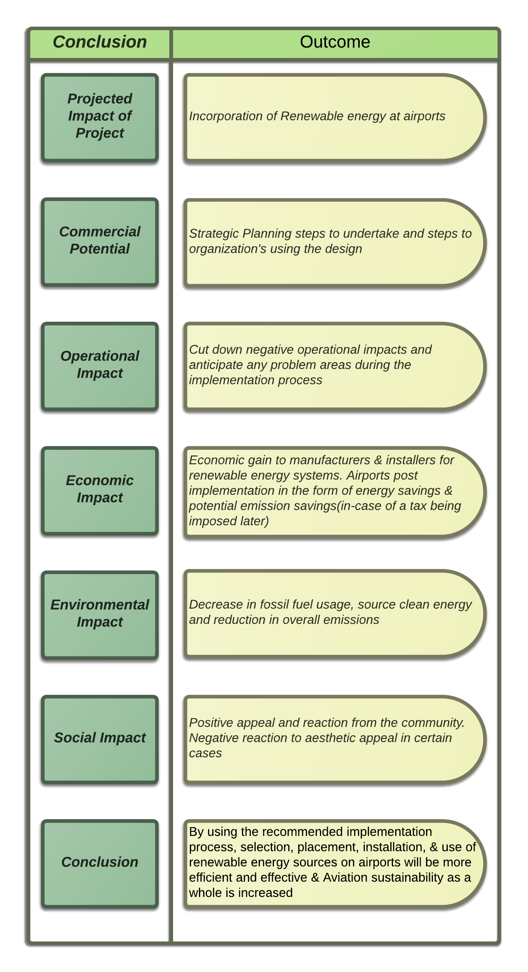
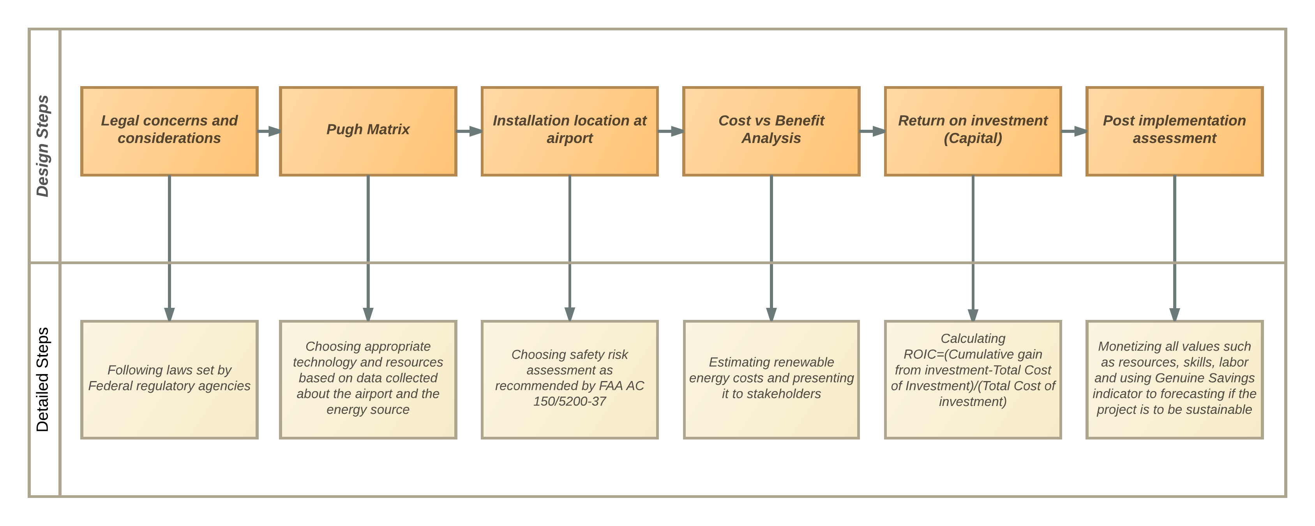
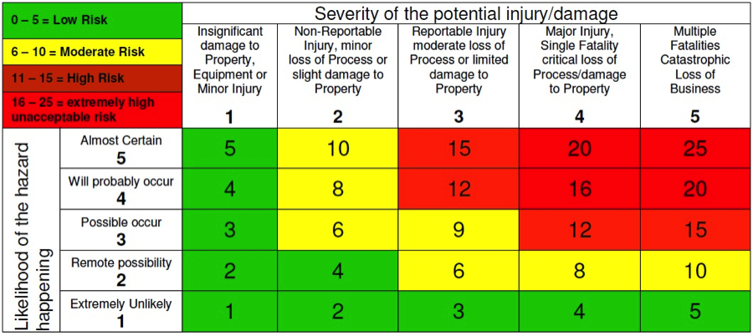
Airport Cooperative Research Program
University Design Competition for Addressing Airport Needs (2015-2016 Academic Year)
Incorporating Renewable Power in U.S. Airports
Rohit Burani, Pedram Motevalli and Emily Thomas
School of Aviation and Transportation Technology, Purdue University
Faculty Advisor: Dr. Mary Johnson, SATT, Purdue Polytechnic Institute
AVIATION SUSTAINABILITY
Aviation sustainability may be thought of as the initiatives taken by the aviation industry to increase efficiency in resource planning. It studies social coherence, environmental quality, and economic welfare and their impact on the terms of ‘sustainable development’ and ‘applied sustainability’ to increase the current and future endurance of aviation as a whole.
EXECUTIVE SUMMARY
Airports account for 5% of the aviation sector's global carbon emissions per year.
Many airports are already implementing innovative change to lower emissions and increase aviation sustainability.
Choosing the best alternative energy source and implementation method for each situation is crucial to the success of these projects.
BACKGROUND
The importance of aviation sustainability recognized by Federal Aviation Administration (FAA) and International Civil Aviation Organization (ICAO).
Programs already being created to support sustainability like:
  FAA’s Noise Compatibility Program
  Voluntary Airport Low Emissions Program
  Airport Improvement Program
LITERATURE REVIEW
ELECTRICAL POWER
Electrical power used to light the facility, and control its temperature; large portion of the energy usage.
Airports consume up to 180M kWh per year in electricity with terminals consuming about 60% of this.
The remaining 40% is allocated to airfield lighting, hangars, and other ancillary buildings.
FUEL
Ground Support Equipment (GSE) like aircraft tugs, baggage carts, and belt loaders, consume a lot of fuel at airports.
WIND ENERGY
Energy created from wind turbines is a renewable.
Location of a group of wind turbines can be problematic.
Normally placed in remote locations due to the obstruction and obstacle that they can create.
ENERGY FROM WATER
This type of energy could be : hydroelectric power, wave power, and tidal power.
Mechanical energy from the turbine blade is converted into electrical energy.
Not feasible as a direct source to be implemented near an airport.
SOLAR ENERGY
Radiant light and heat from the sun; collected and converted into form of renewable energy.
Estimated cost of solar technologies would decrease by about 75% between 2010 and 2020.
Potential growth and affordability of solar power makes it a promising alternative to conventional energy sources.
INDIANAPOLIS INTERNATIONAL AIRPORT (KIND)
Partnered with local companies and government to install a large solar field on the airport grounds.
Leadership in Energy & Environmental Design (LEED) certified buildings to promote renewable energy and reduce power consumption.
Power produced by the solar panels is fed directly into the grid for community use.
HANGAR 25 AT BOB HOPE AIRPORT (KBUR)
Uses only solar power.
Power lights, computers, office equipment, ceiling fans, and even charges electric Ground Service Equipment
SEYMOUR AIRPORT (SEGS), ECUADOR
First airport terminal to be powered exclusively on wind and solar energy.
Terminal is constructed entirely of recycled or environmentally responsible materials .
Solar panels provide 35% of the power production, while four wind turbines provide the remaining 65%.
COCHIN INTERNATIONAL AIRPORT (VOCI), INDIA
First airport to be completely powered by solar power
Land use: 45 acres
Airport draws power from its own grid and gives surplus to state
Current Project being expanded to produce 200 MWh in the next 10 years
ROIC: $9.4 million in 6 years by selling power to the state
DESIGN STEPS
PUGH MATRIX
RISK ASSESSMENT
Direct all correspondence about this research to: Mr. Rohit Burani (rburani@purdue.edu)

